Slide 1
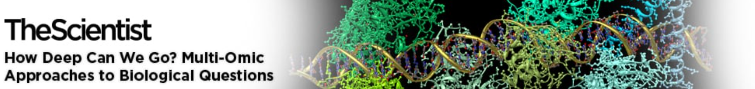


Multi-Omics in Cancer Biomarker Discovery
Benjamin Haibe-Kains
Senior Scientist, Princess Margaret Cancer Centre
Associate Professor, University of Toronto
Affiliate, OICR and Vector Institute
bhaibeka@uhnresearch.ca
@bhaibeka
June 28, 2021
Notes:
https://www.med.uio.no/klinmed/english/research/projects/knep-norwegian-cancer-society-national-group-of-expertise-pancreatic-cancer/index.html

Slide 2
Event details
The omics revolution changed how scientists approach scientific questions, allowing them to expand the scope and depth of their studies. Now, advances in data processing and analysis facilitate multi-omic studies. In this webinar from The Scientist, Benjamin Haibe-Kains and Rachelly Normand will discuss multi-omic approaches for cell atlas construction, biomarker discovery, and disease research.
Topics to be covered
Multi-omic approaches for cancer biomarker discovery
Constructing an atlas for the SARS-CoV-2 pathological response

Slide 3
Contents
The need for multi-omics in precision oncology
Data challenges → ORCESTRA + PharmacoGx
One omics to rule them all?
Combining omics
Convergence vs complementarity
SNF / DNF
Gevaert
Deep learning
Sharing + Research Reproducibility → Code Ocean
Future directions: Radiomics + ctDNA

Slide 4
Disclosures
I am a co-Founder of the MAQC (Massive Analysis and Quality Control) Society
I am part of the Scientific Advisory Board of:
Consortium de recherche biopharmaceutique (CQDM), Quebec, Canada
Break Through Cancer, Commonwealth Cancer Consortium, United States
Canadian Institute of Health Research - Institute of Genetics, Canada
I am part of the Executive Committee of the Terry Fox Digital Health and Discovery Platform, Canada
I am part of the Board of Directors of AACR International - Canada, The American Association for Cancer Research, United States
I am a consultant for Code Ocean Inc, United States

Slide 5
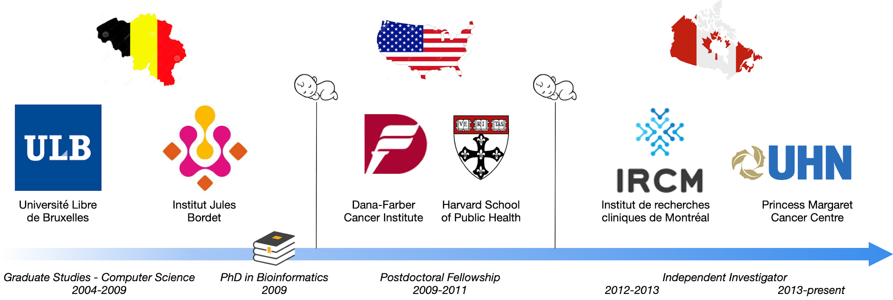

Benjamin Haibe-Kains, PhD
Research interests: Pharmacogenomics and Radiomics in Cancer
Sustainable Scientific Software
bhaibeka@uhnresearch.ca
@bhaibeka
PMCRT 11-310, 101 College Street, Toronto M5G1L7

Slide 6



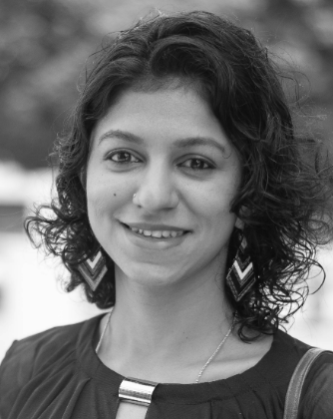




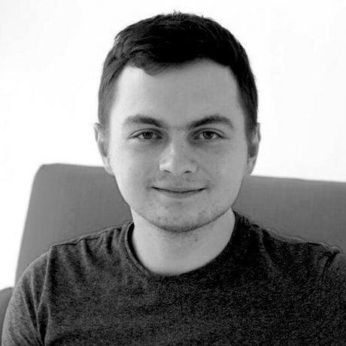

The real heroes
Petr Smirnov
Gangesh Beri
Christopher Eeles
Sisira Kadambat Nair
Anthony Mammoliti
Evgeniya Gorobets
Nikta Feizi
Minoru Nakano
Denis Tkachuk
Zhaleh Safikhani

Slide 7
Multi-omics for precision oncology

Slide 8
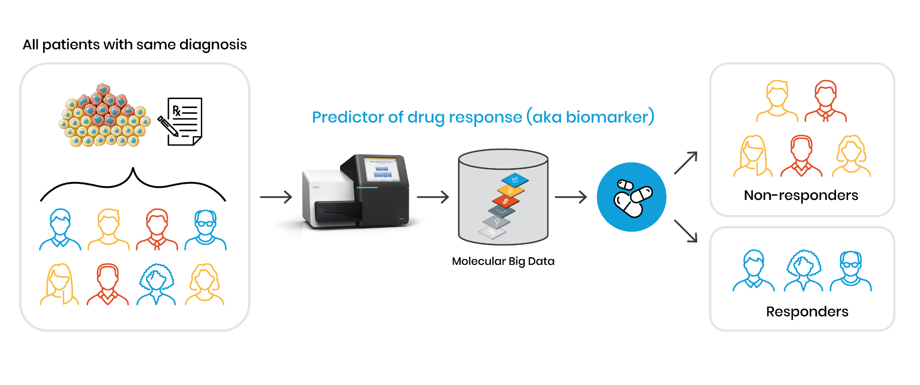
Multi-omics for precision oncology

Slide 9
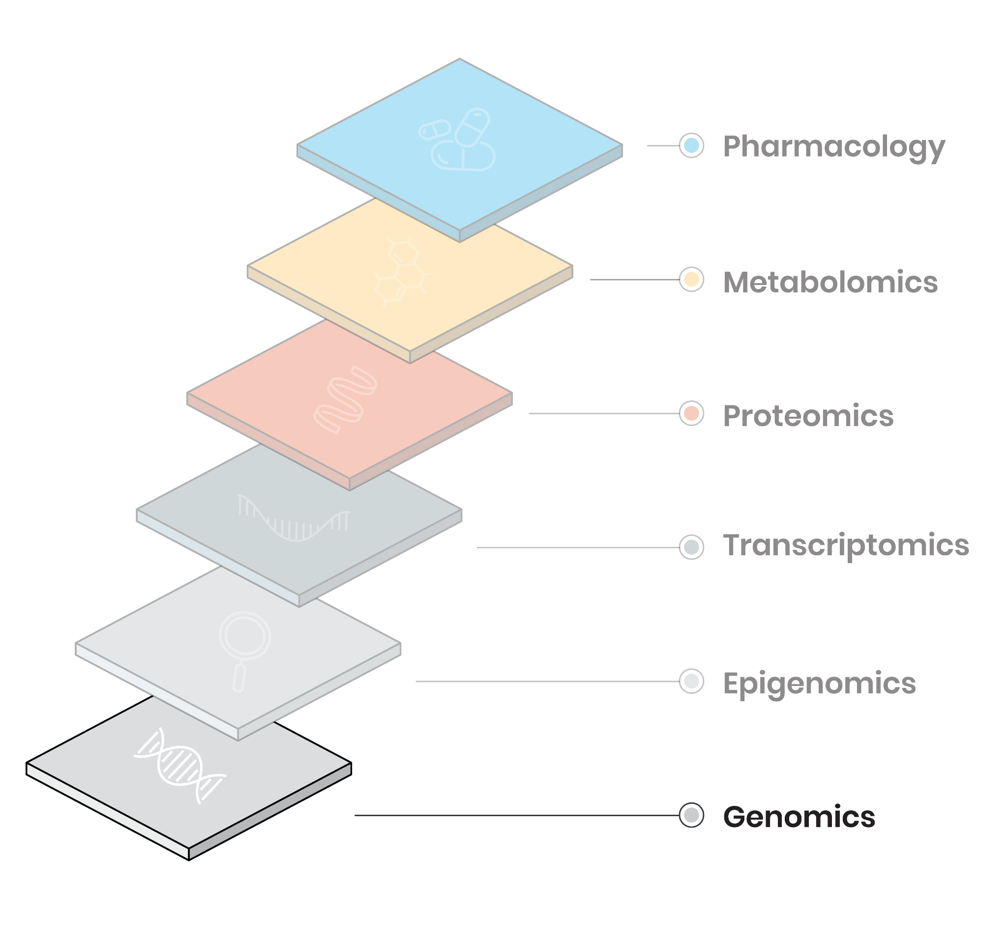
Measuring biological features at multiple levels
Mutations, copy number and structural variations, gene fusions (single nucleotide polymorphism microarray, whole-genome/exome sequencing)

Slide 10
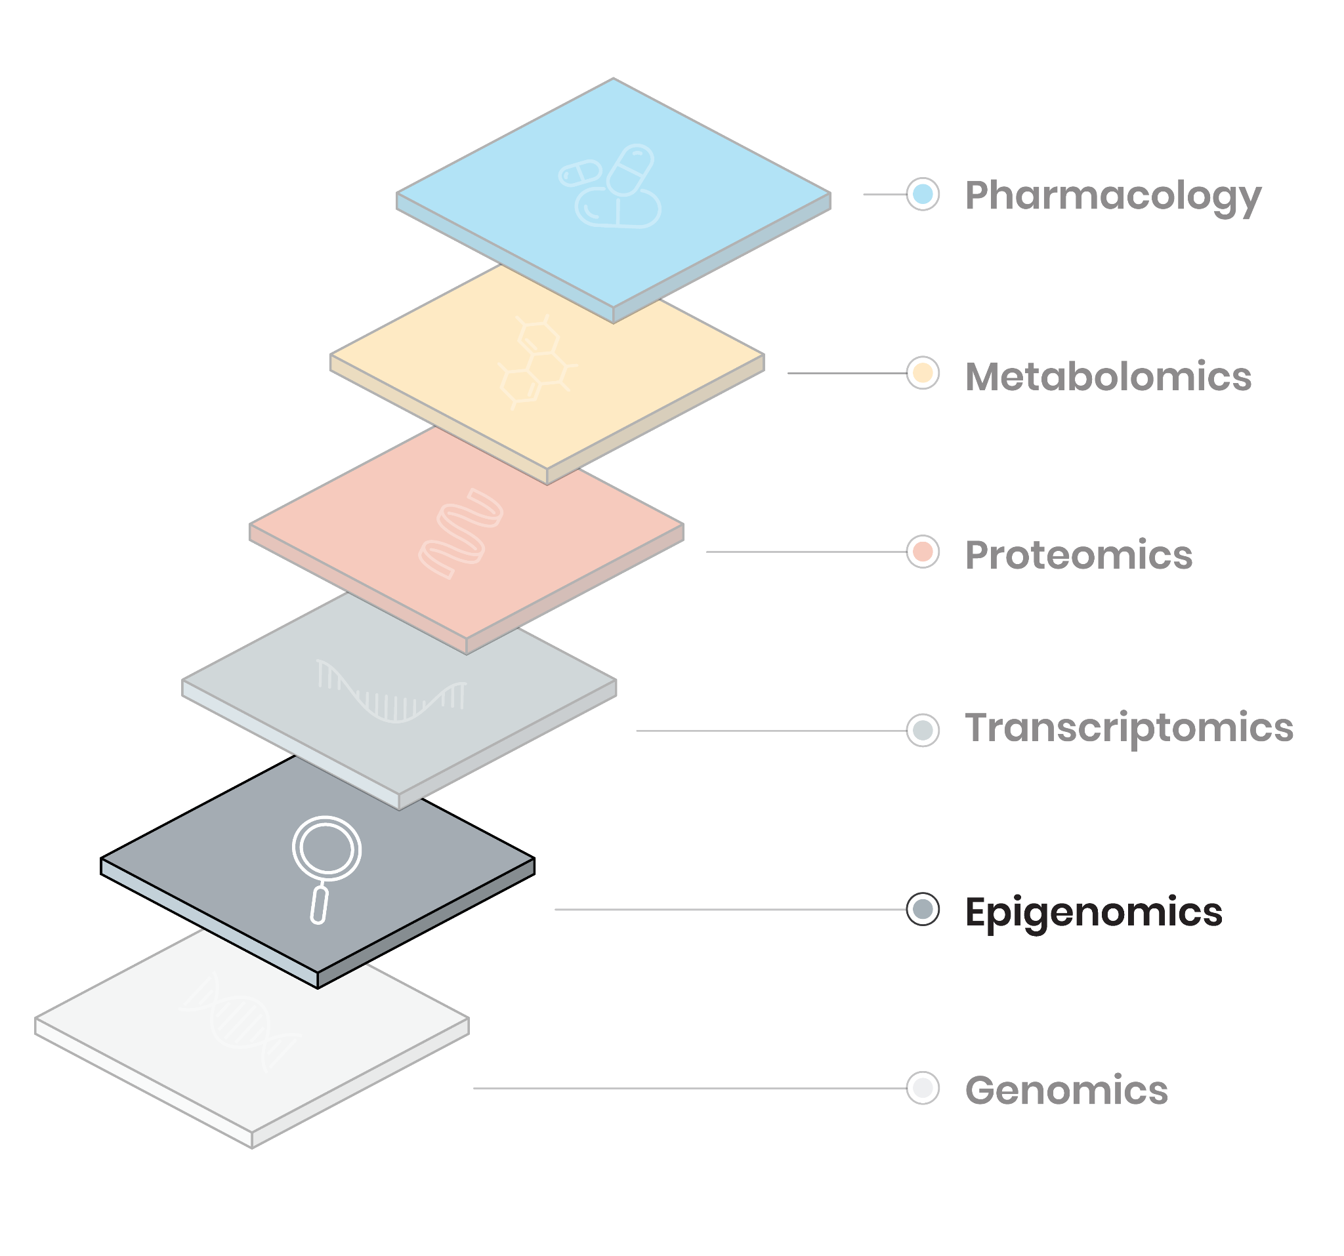
Measuring biological features at multiple levels
Methylation, chromatin accessibility
(reverse bisulfite sequencing, ATAC-seq)

Slide 11
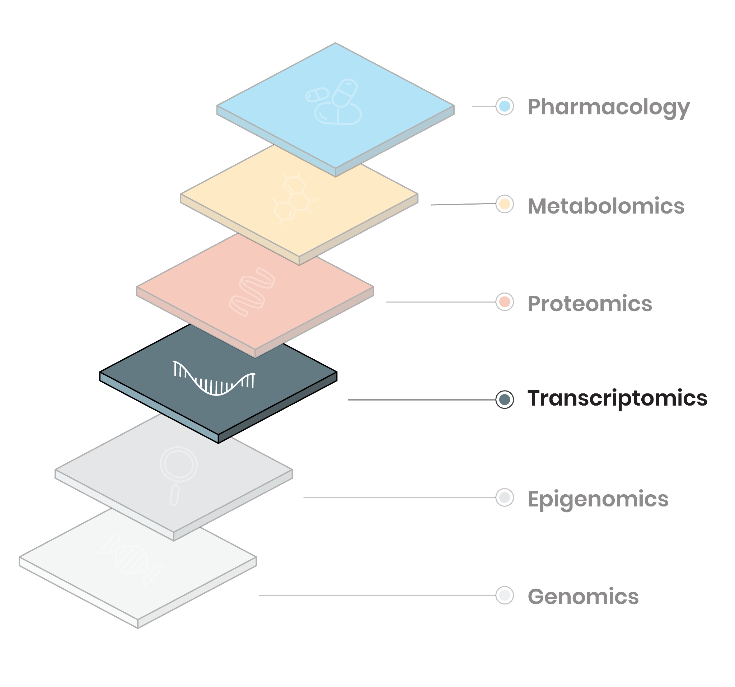
Measuring biological features at multiple levels
Messenger and non-coding RNAs, transcript fusions (gene expression microarrays, RNA-seq)

Slide 12
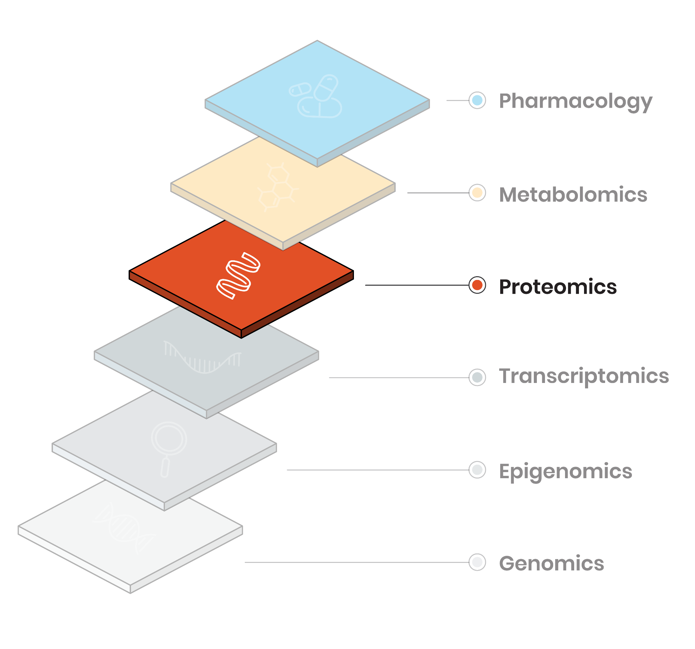
Measuring biological features at multiple levels
Protein abundance, protein complexes, phosphorylation (Mass-spectrometry, Reverse Phase Protein Array)

Slide 13
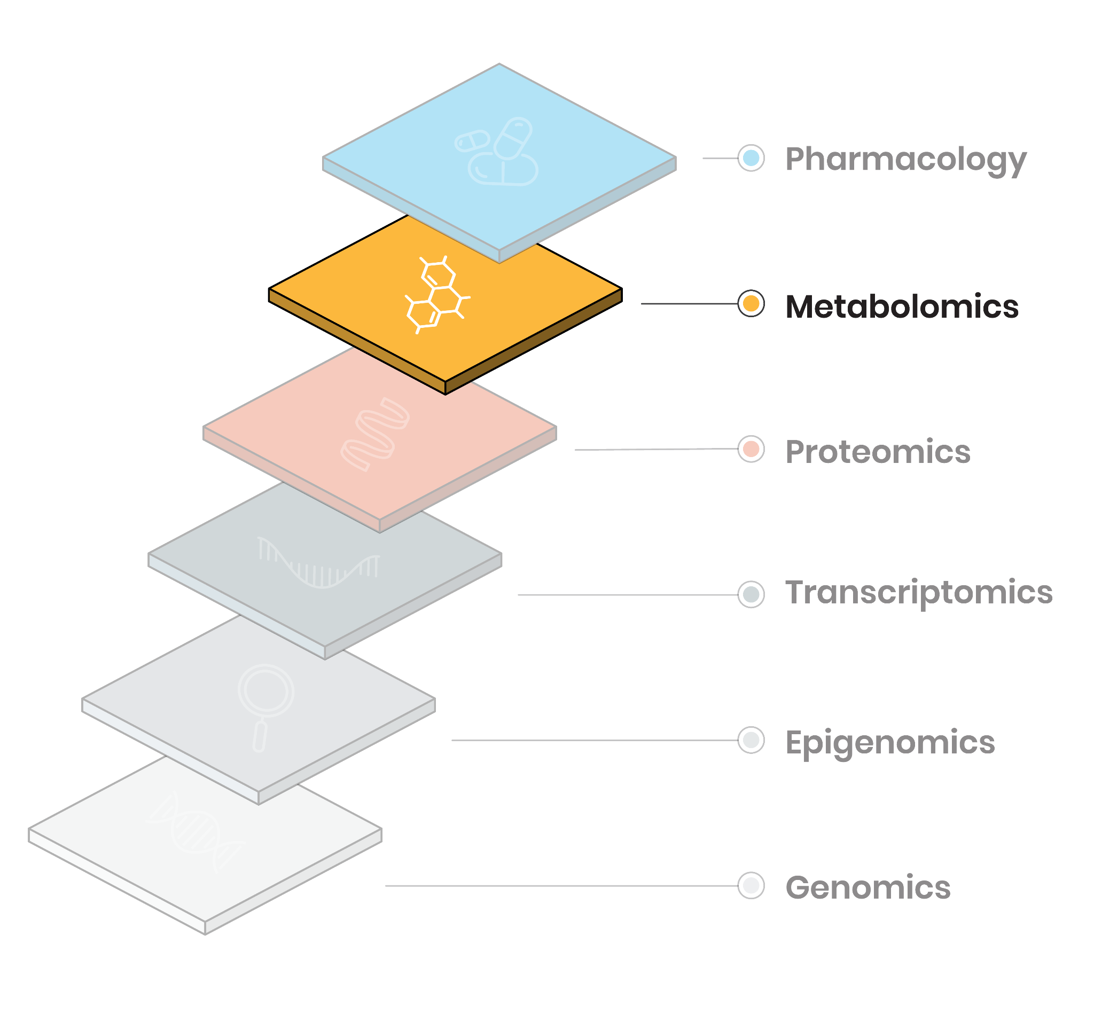
Measuring biological features at multiple levels
Metabolite abundance
(Nuclear magnetic resonance, mass spectrometry)

Slide 14
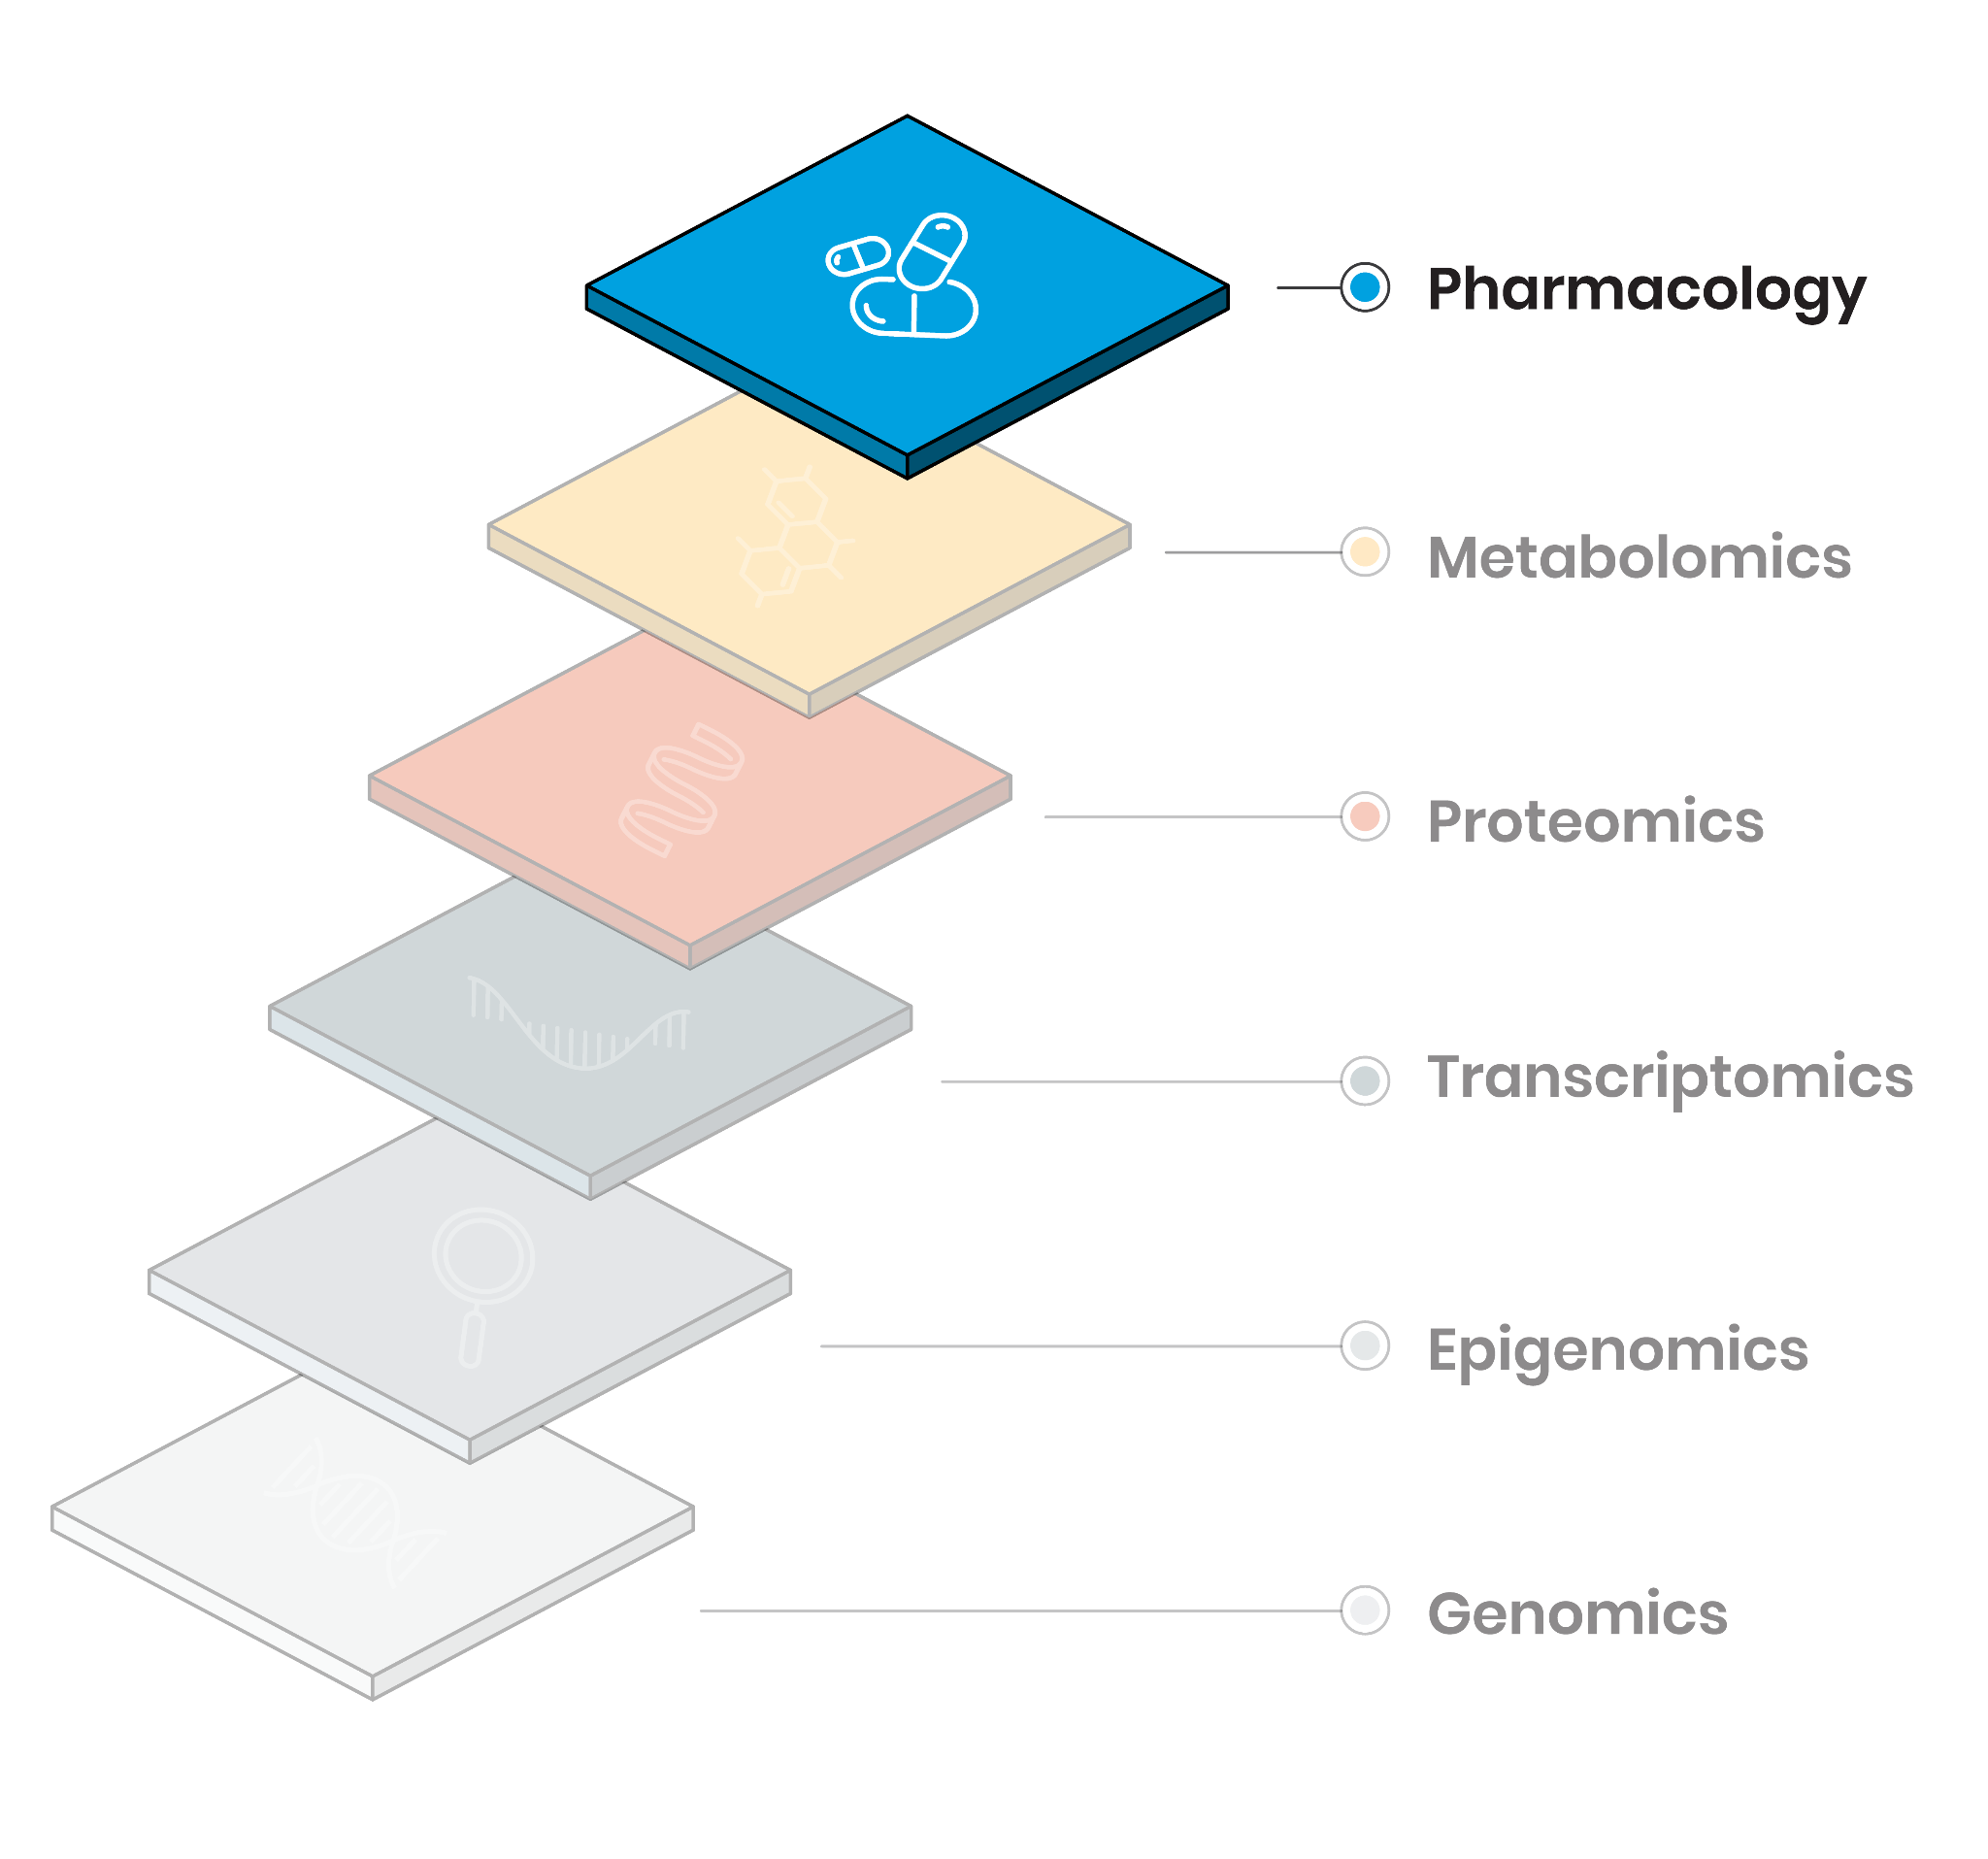
Measuring biological features at multiple levels
Drug response, cell viability
(RECIST, tumor growth, Syto60, Cell Titer Glo)

Slide 15
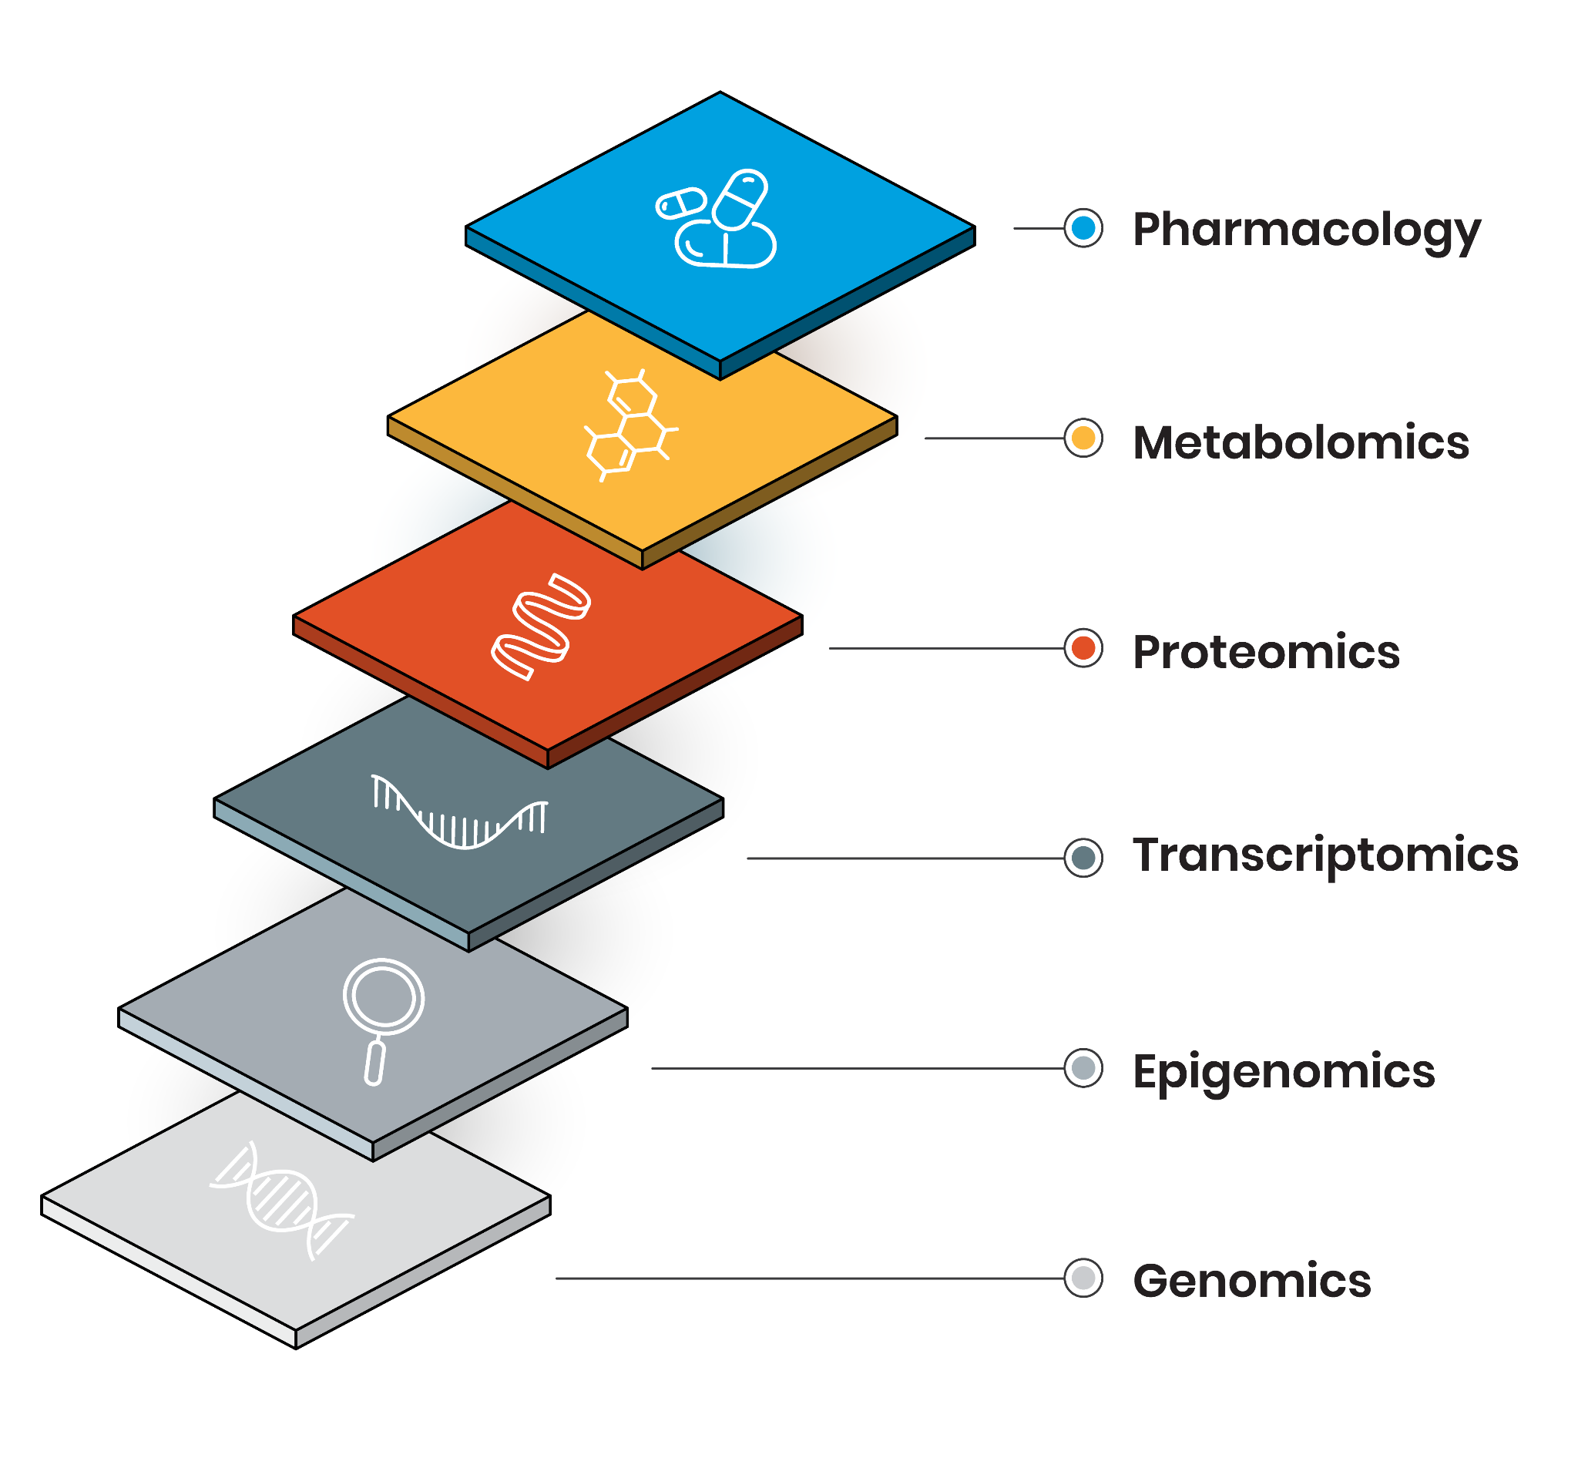
Measuring biological features at multiple levels
Drug response, cell viability
(RECIST, tumor growth, Syto60, Cell Titer Glo)
Metabolite abundance
(Nuclear magnetic resonance, mass spectrometry)
Protein abundance, protein complexes, phosphorylation (Mass-spectrometry, Reverse Phase Protein Array)
Messenger and non-coding RNAs, transcript fusions (gene expression microarrays, RNA-seq)
Methylation, chromatin accessibility
(reverse bisulfite sequencing, ATAC-seq)
Mutations, copy number and structural variations, gene fusions (single nucleotide polymorphism microarray, whole-genome/exome sequencing)

Slide 16
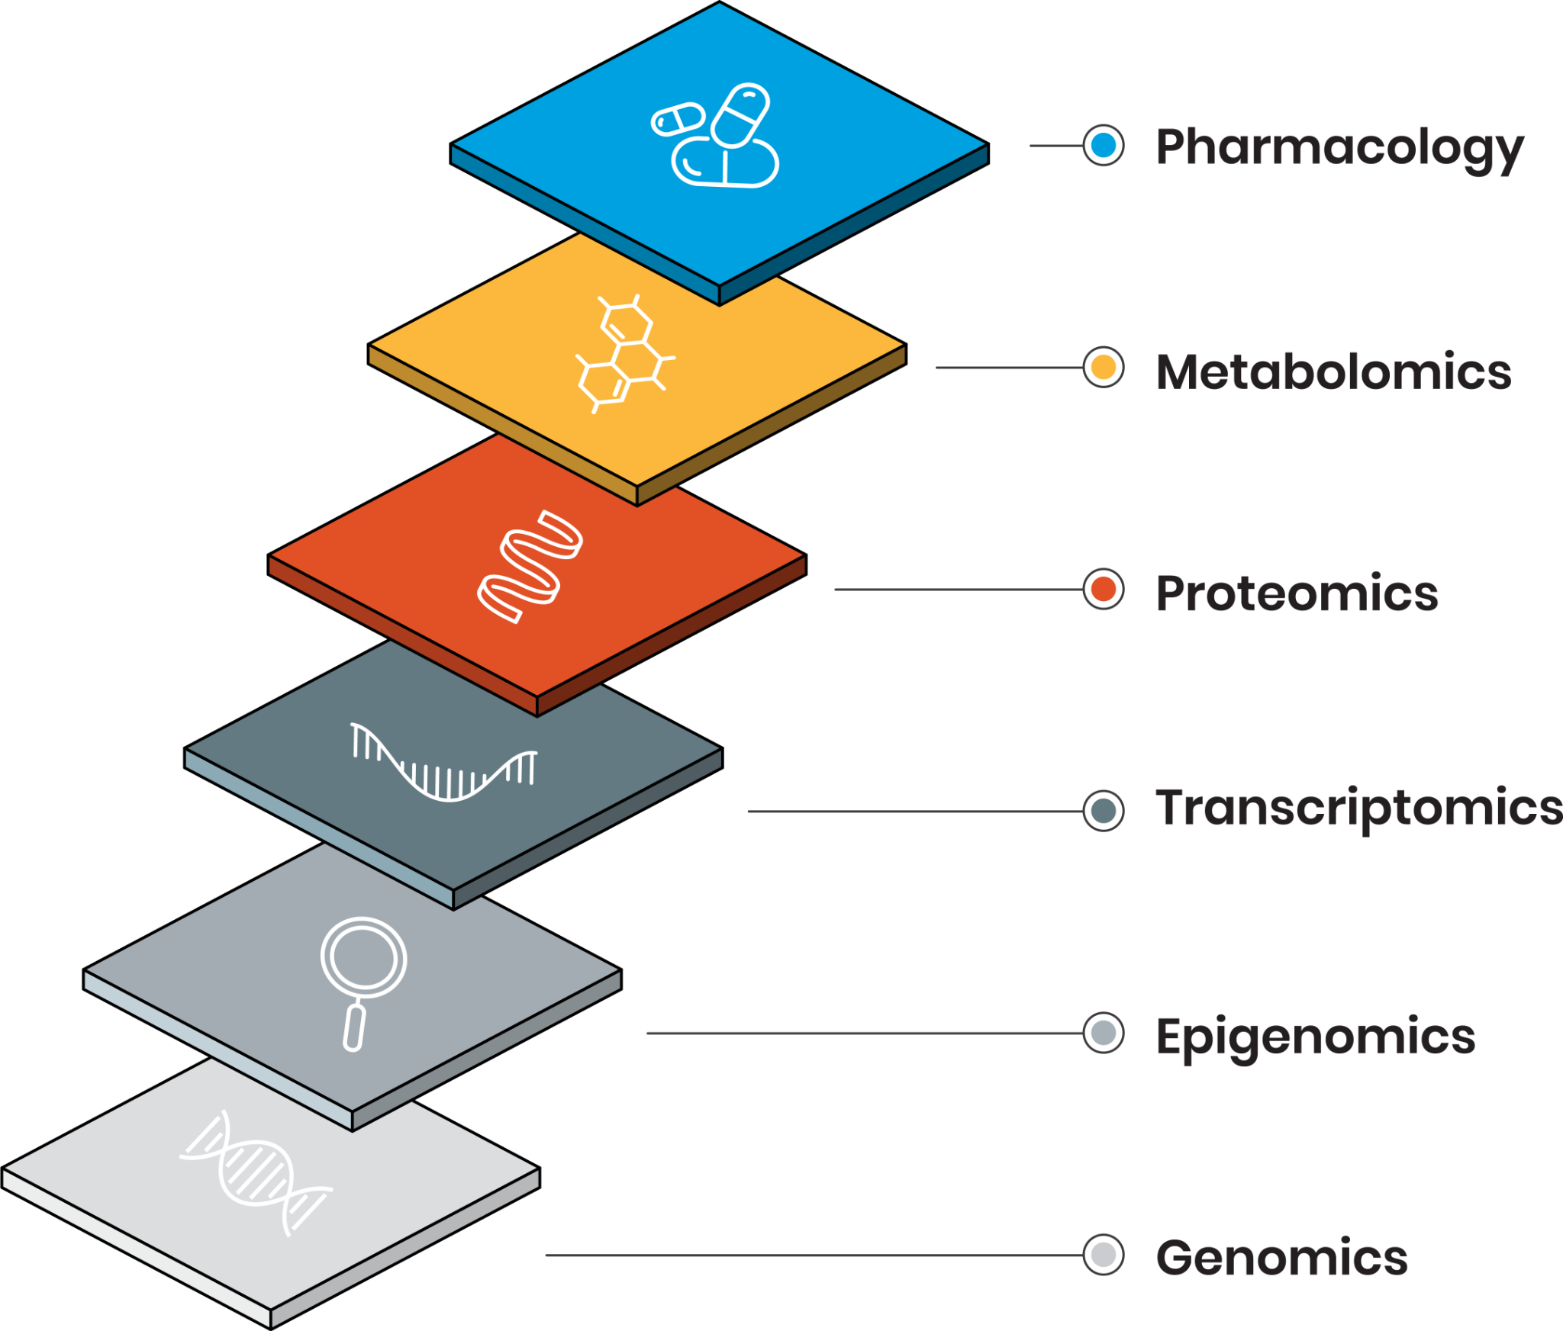
Measuring biological features at multiple levels
Drug response, cell viability
Metabolite abundance
Protein abundance, protein complexes, phosphorylation
Messenger and non-coding RNAs, transcript fusions
Methylation, chromatin accessibility
Mutations, copy number and structural variations, gene fusions

Slide 17
What is a biomarker?
A biomarker is anything that can be used as a measurable indicator of
a particular disease state ➞ diagnostic or prognostic biomarker
a particular response to a drug ➞ predictive biomarker

Slide 18
What is a biomarker?
A biomarker is anything that can be used as a measurable indicator of
a particular disease state ➞ diagnostic or prognostic biomarker
a particular response to a drug ➞ predictive biomarker
Biomarkers can be measured using different technologies
Arrays, sequencing, staining, ...
Univariate biomarkers
Multivariate biomarkers, often referred to as signatures, predictors or companion diagnostics
Single or multiple modalities (omics)

Slide 19
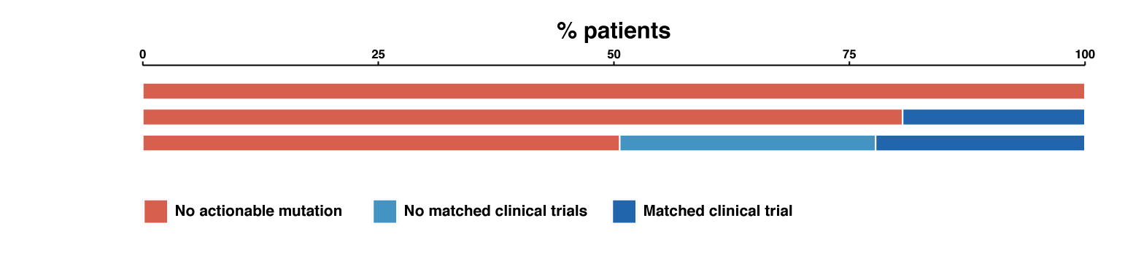
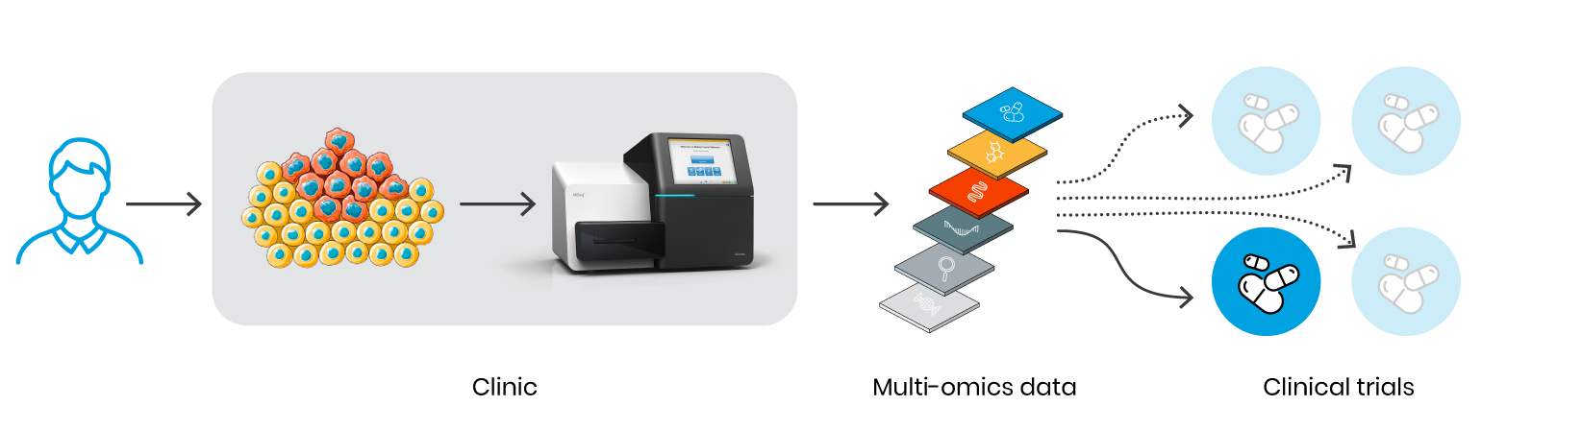
Basket/Umbrella (biomarker-driven) clinical trials
% patients in biomarker-driven clinical trials
Clinical Trial x
No actionable mutation

Slide 20
Basket/Umbrella (biomarker-driven) clinical trials
% patients in biomarker-driven clinical trials
Clinical Trial x
Clinical Trial y
No actionable mutation
Matched clinical trials

Slide 21
Basket/Umbrella (biomarker-driven) clinical trials
% patients in biomarker-driven clinical trials
Clinical Trial x
Clinical Trial y
Clinical Trial z
No actionable mutation
Matched clinical trials
No active clinical trials
Large investments in major cancer centres
Only ~50% patients could be matched to clinical trials based on targeted sequencing

Slide 22
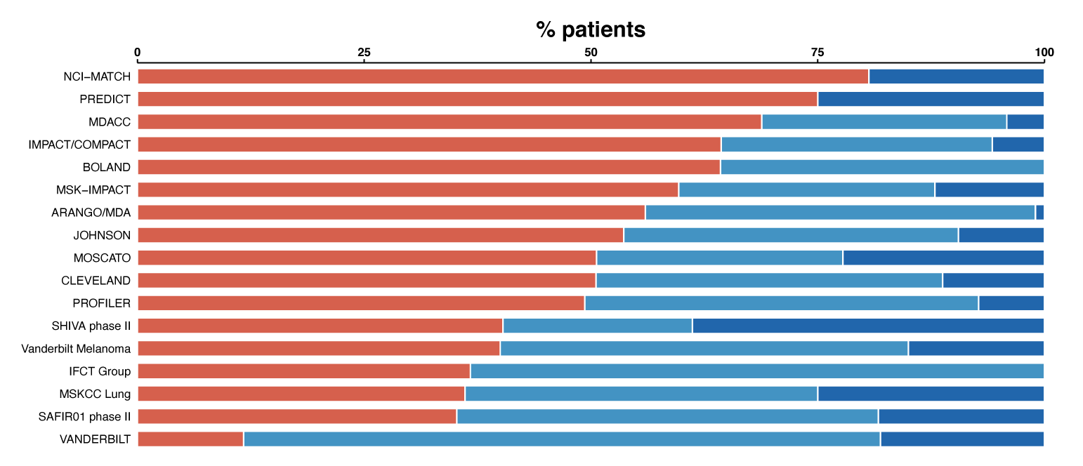
Basket/Umbrella (biomarker-driven) clinical trials
% patients in biomarker-driven clinical trials
Clinical Trials
No actionable mutation
No active clinical trials
Matched clinical trials
Remon and Dienstmann, ESMO Open 2018

Slide 23
Challenges for matching patients to therapies
Access to drugs, not enough active clinical trials
Small sequencing panels
Profiling usually limited to a single assay (DNA, mRNA or protein)
Biomarkers (companion diagnostics) are usually univariate
Notes:
However, the problem with the genetic model is that it is underpowered.
Despite billions of $ invested in sequencing thousands of tumours in the last decade or so, scientists only found mutations in 66 out of 26,000 genes to inform of treatment options. This “gold mine” is running dry.

Slide 24

Challenges for matching patients to therapies
Access to drugs, not enough active clinical trials
Small sequencing panels
Profiling usually limited to a single assay (DNA, mRNA or protein)
Biomarkers (companion diagnostics) are usually univariate
Very few known gene-drug associations (biomarkers)
We barely scratched the surface!
Only 156 out of ~26,000 genes have been associated with drug response
Only 100 drugs out of ~620 anticancer drugs have an associated biomarker
Multi-omics predictors of drug response

Slide 25
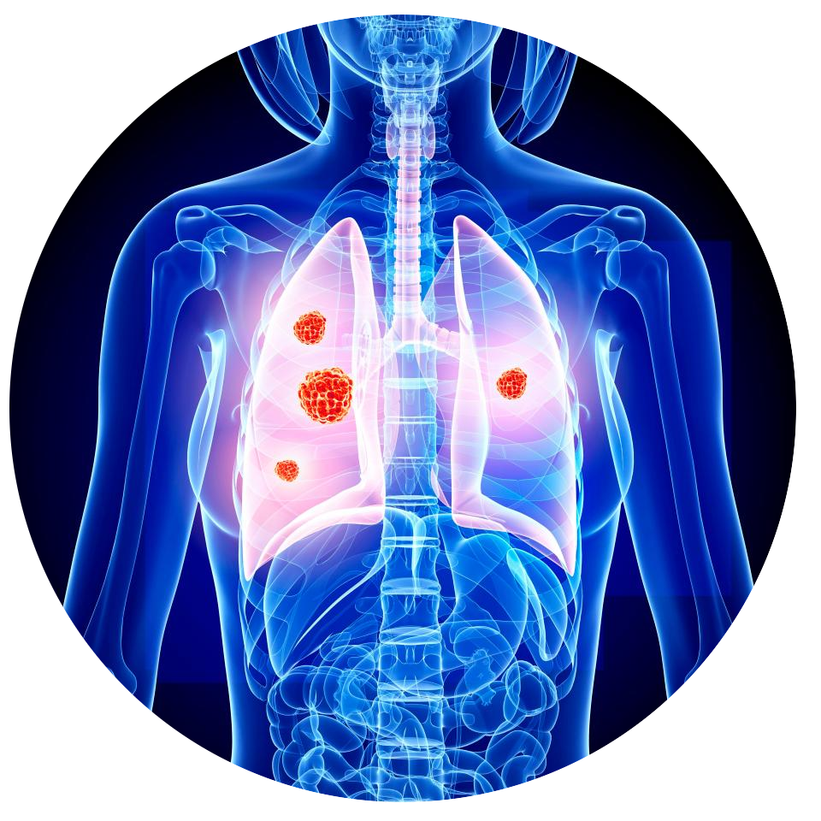
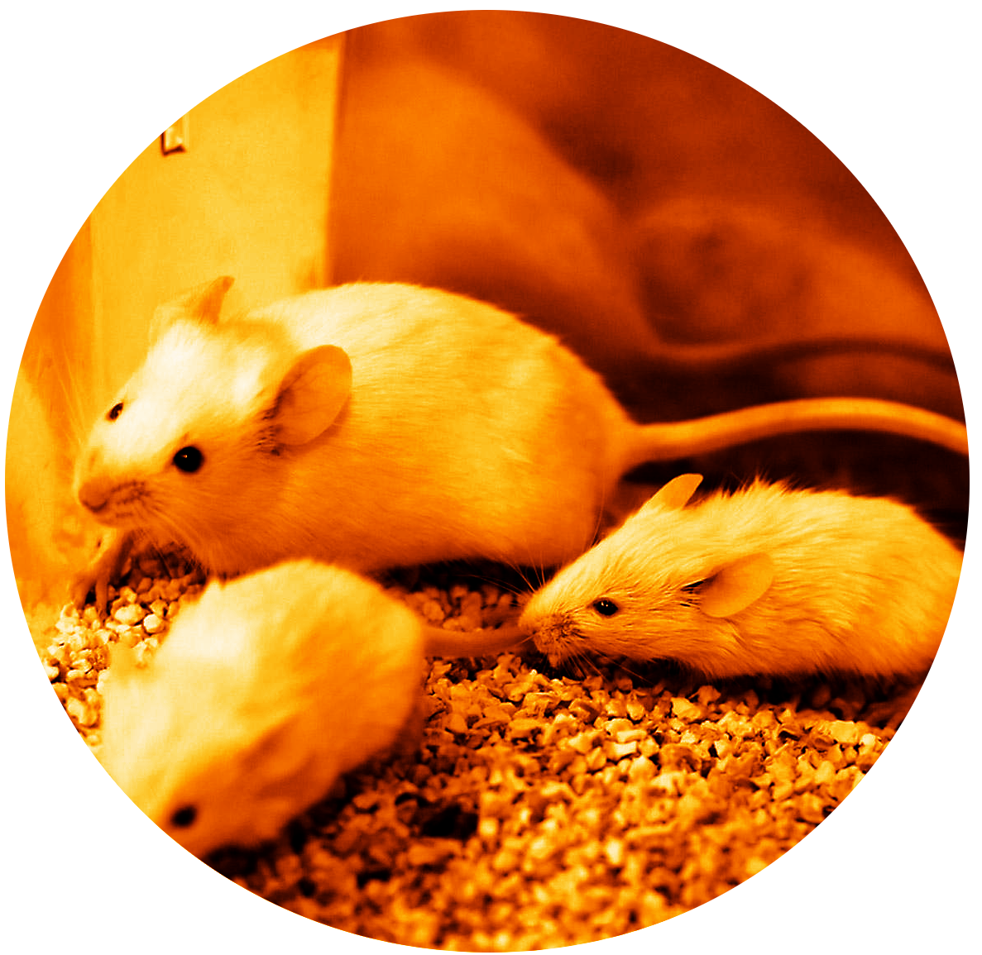
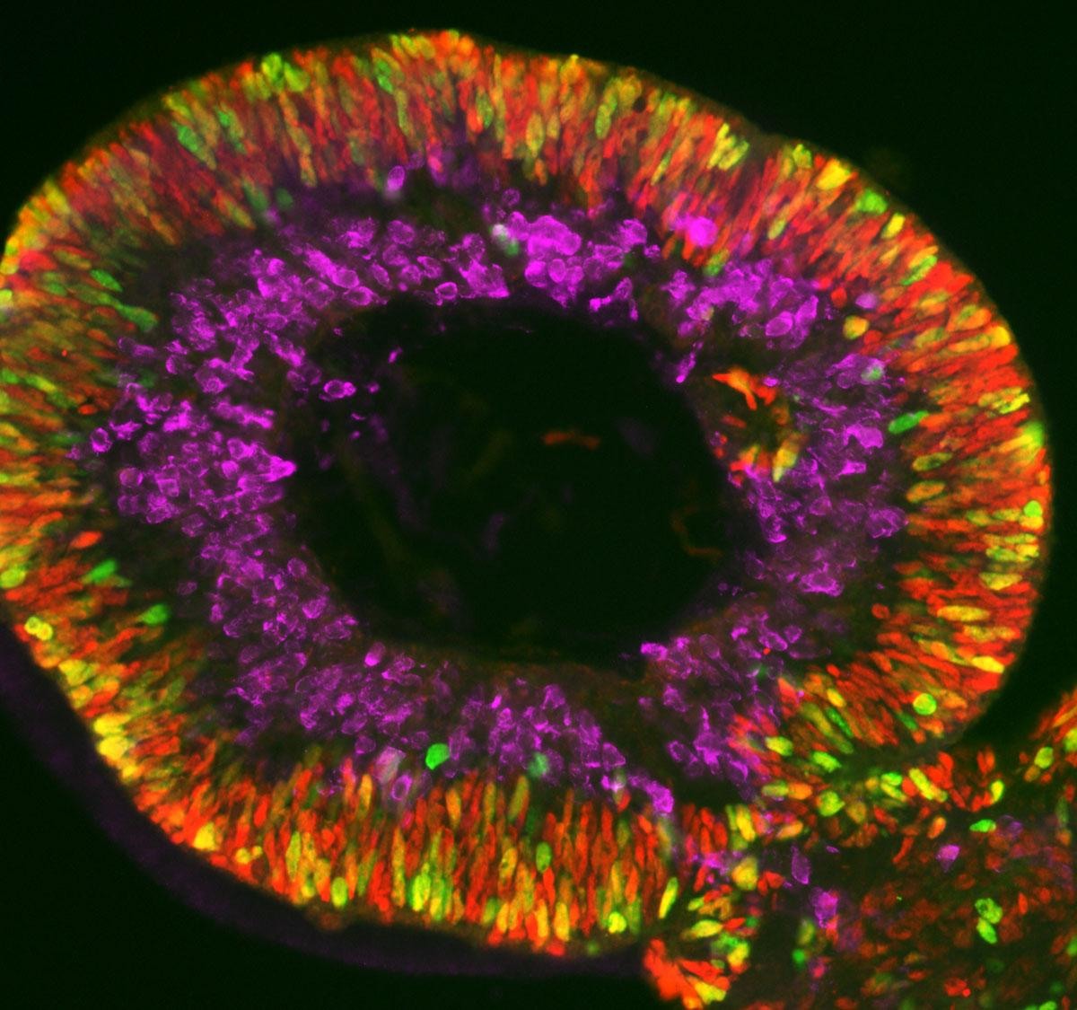
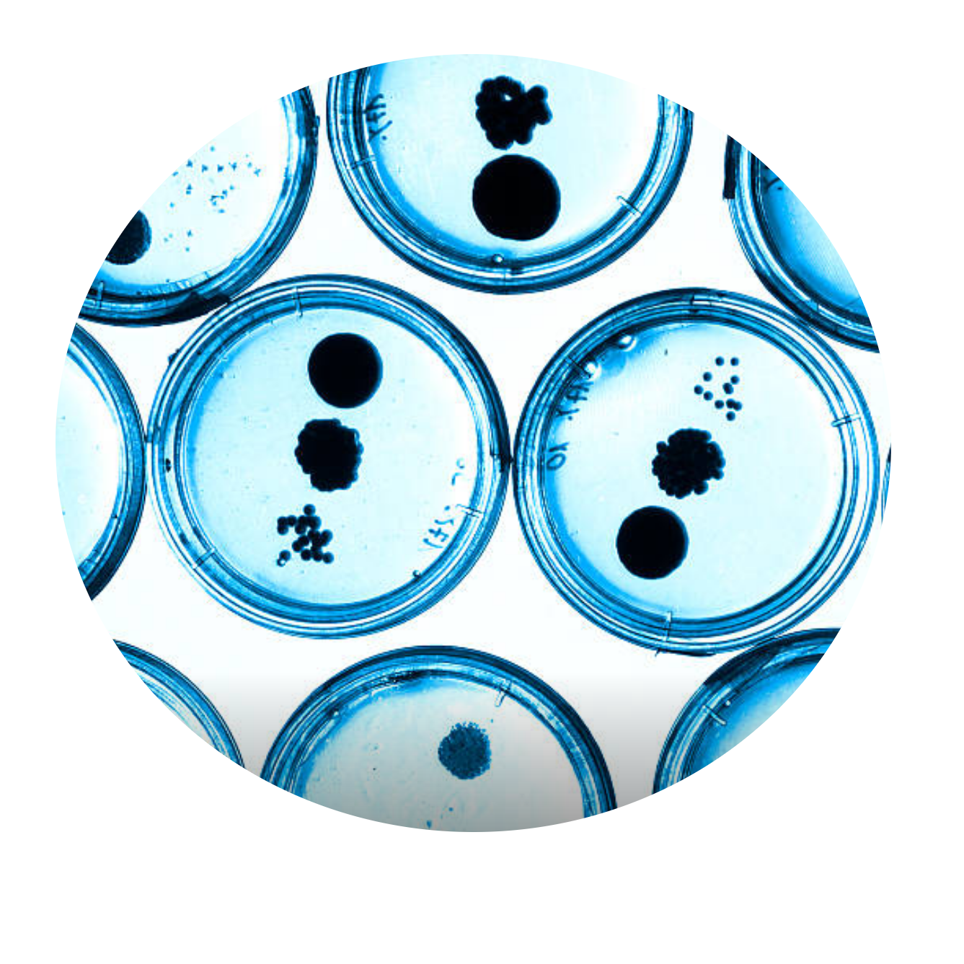
Biological materials for biomarker discovery
Preclinical model systems
Patient
Mouse Model
Organoid
Cell Line
Cost / Time
Sample size
Notes:
Best biological materials to identify biomarkers relevant to clinic but
Collecting biopsies from a large cohort of patients is not always feasible
Ethics
Limited to approved drugs
Costly
Lengthy

Slide 26
Biological materials for biomarker discovery
Preclinical model systems
Patient
Mouse Model
Organoid
Cell Line
Clinical relevance
Probe and perturb
Notes:
Best biological materials to identify biomarkers relevant to clinic but
Collecting biopsies from a large cohort of patients is not always feasible
Ethics
Limited to approved drugs
Costly
Lengthy

Slide 27
Are immortalized cell lines relevant for biomarker discovery?
Most clinically-approved biomarkers were first discovered in cell lines
Sample size: large, diverse set of cancers (1500+)
Many drugs can be investigated in parallel
Both experimental and approved drugs
Classes of drugs with similar mechanism of action
Easy to generate lots of pharmacological and multi-omics data
Robotic platforms enable experimental replication on a large scale
Use of the same material across laboratories
Immortalized cell lines are relatively simple in vitro 2D models
If one cannot predict drug response in cell lines, therapy response prediction in vivo seems unachievable!

Slide 28
Biological materials for biomarker discovery
Preclinical model systems
Patient
Mouse Model
Organoid
Cell Line
Clinical trials
Preclinical trials
Notes:
Best biological materials to identify biomarkers relevant to clinic but
Collecting biopsies from a large cohort of patients is not always feasible
Ethics
Limited to approved drugs
Costly
Lengthy

Slide 29

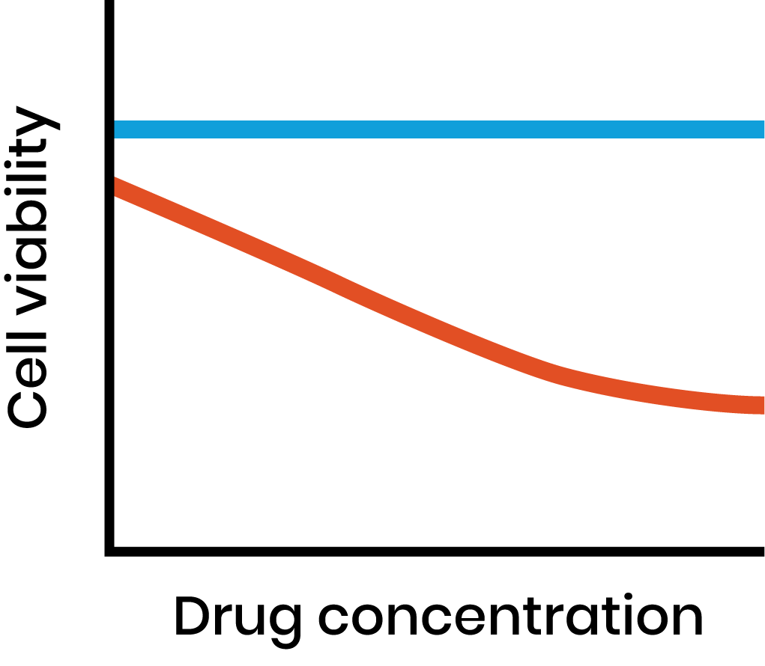
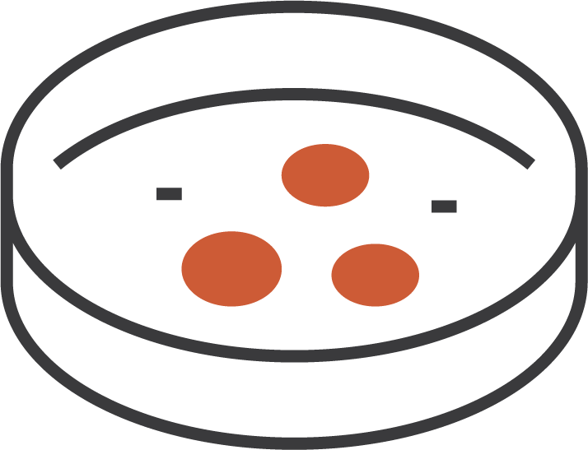
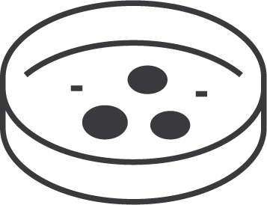
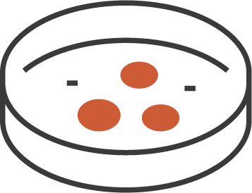
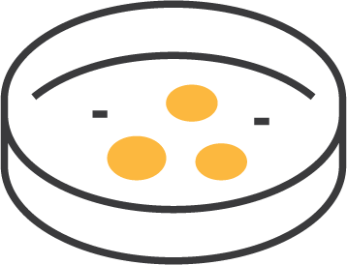
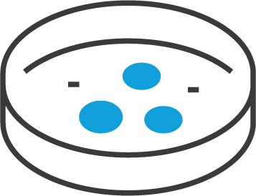
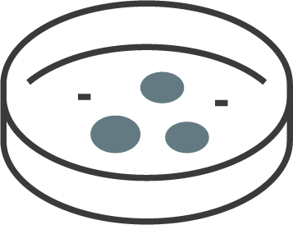
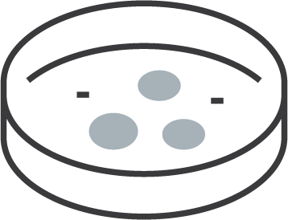
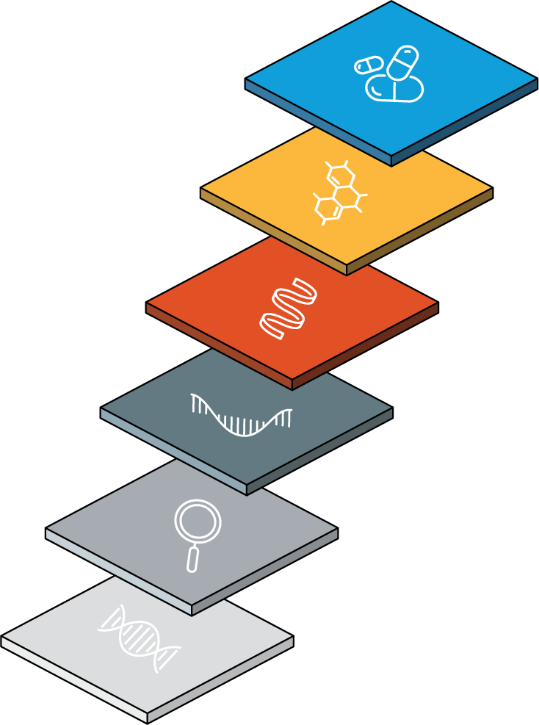
Cell line-based (in vitro) pharmacogenomic data
Drug sensitivity screening
Y
Collection of cancer models
=
Live Cells
f(X)
Biomarker discovery
Comprehensive molecular profiling
X
Live Cells

Slide 30
Data challenges

Slide 31
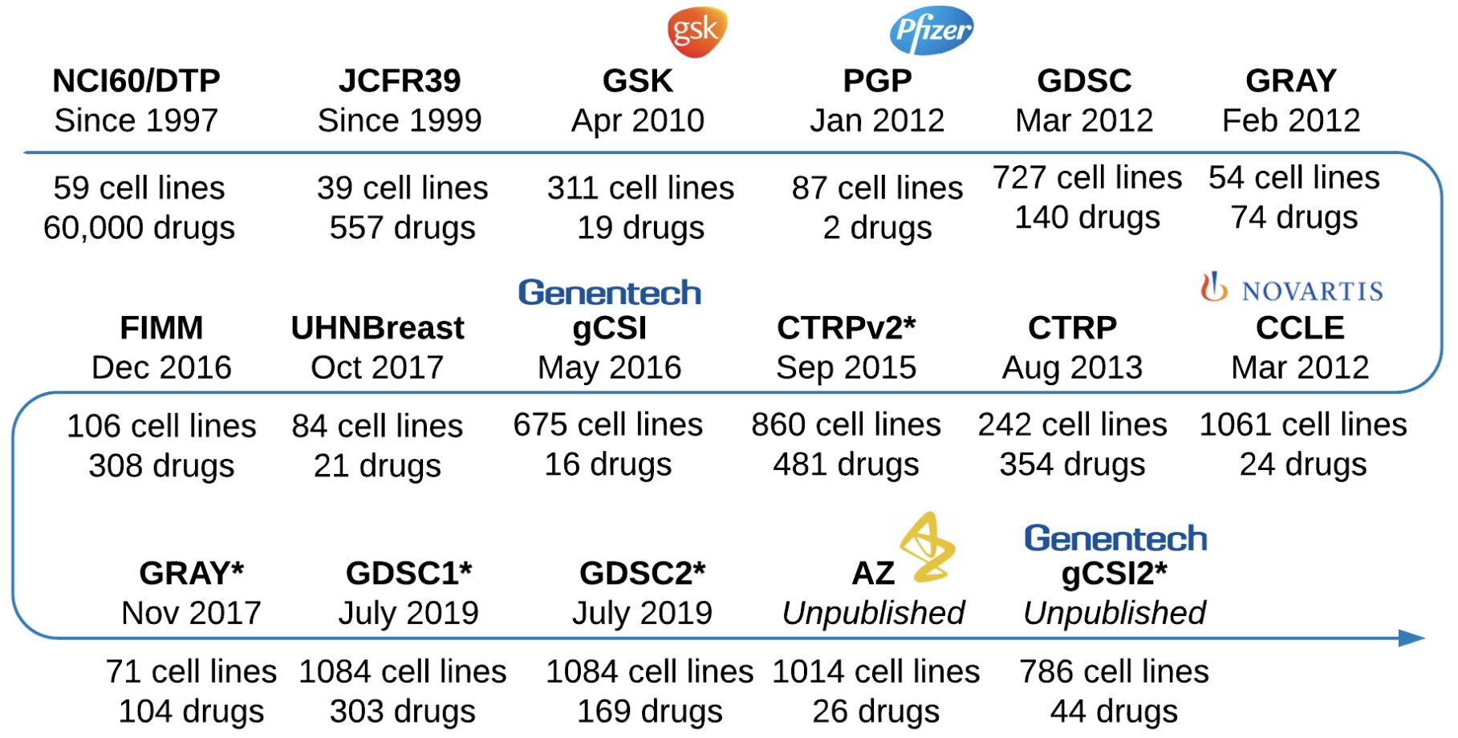
Cell line-based pharmacogenomic studies
* Updates

Slide 32
Data challenge in pharmacogenomics
Lack of standards for
Heterogeneous sample and drug annotations
Pharmacological profiles released using diverse (undocumented) formats
Annotations are not consistent across data modalities
Lack of metadata regarding
Experimental designs
Modeling and summarization of the drug response
Pharmacogenomic data often not directly amenable to statistical / ML analysis
Need to improve the “FAIRness” of pharmacogenomic data
Findable + Accessible + Interoperable + Reusable
Make pharmacogenomic research more Reproducible

Slide 33
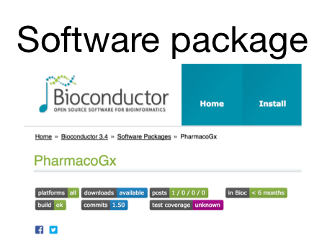
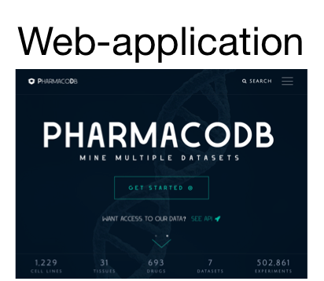
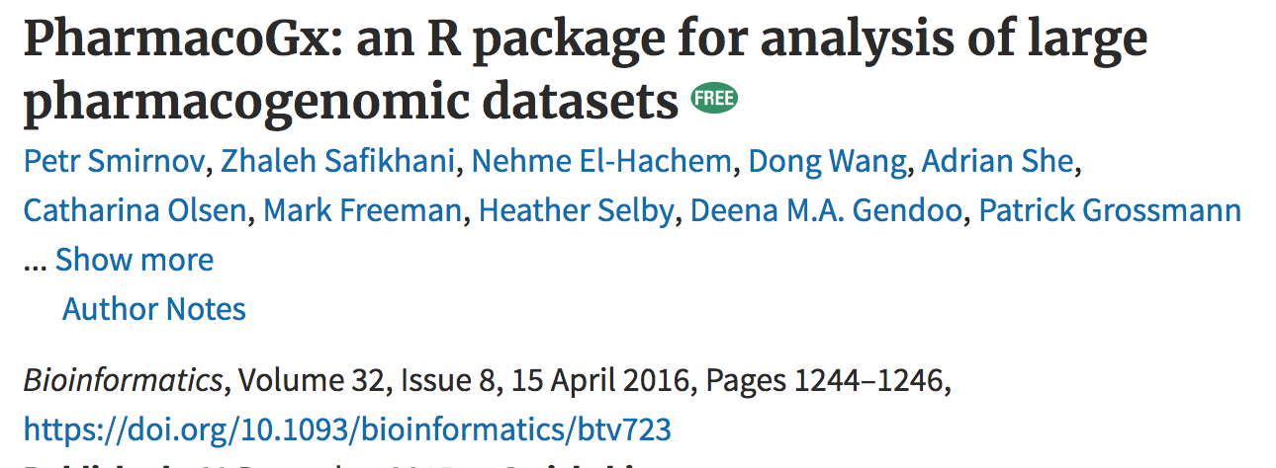
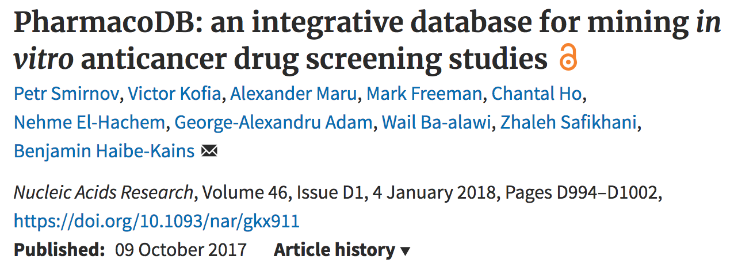
The PharmacoGx toolbox
Datasets | Cell Lines | Tissues | Compounds | Drug Dose-Response Experiments
8 | 1,676 | 41 | 920 | 1 Million+

Slide 34
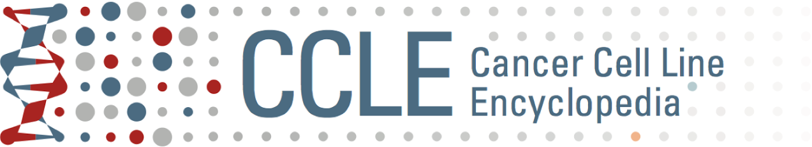
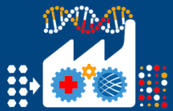

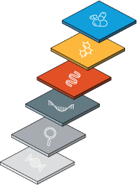

Example of dataset
Largest collection of cancer cell lines from the Broad’s Cell Line Factory
High-throughput pharmacological profiling
1094 cell lines spanning 25 tissues
24 anticancer drugs using Cell Titer Glo assay
Multi-omics profiling
Mutations, gene fusions, translocations
Copy number variations
Transcripts and gene expressions
Methylation profiling
Proteomics
Metabolomics
Global chromatin profiling
Curation and integration:
PubChem, InchKey and SMILES for drugs
Cellosaurus for cell lines
Ensembl for gene annotations
Multimodal data integrated into a PharmacoSet object
Available soon in PharmacoGx

Slide 35




FAIR Principles for data sharing
F
indable
Describing data with metadata and a persistent unique identifier
Accessible
Accessing (meta)data with authentication using the
unique identifier
Interoperable
Ability to integrate (meta)data with other data
+ applications and workflows
Reusable
Rich metadata and
detailed provenance (data lineage)

Slide 36
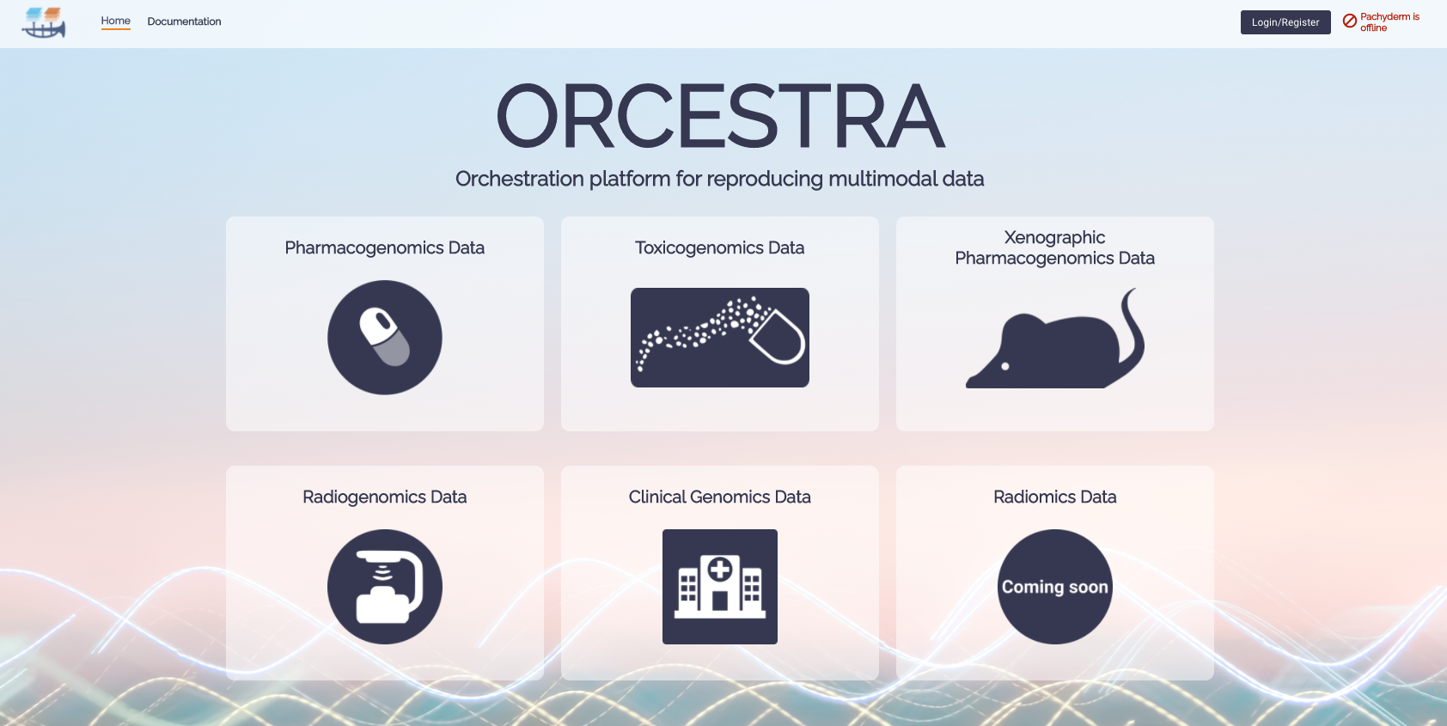
Reproducible processing of multi-omics pharmacogenomic data
https://www.orcestra.ca

Slide 37
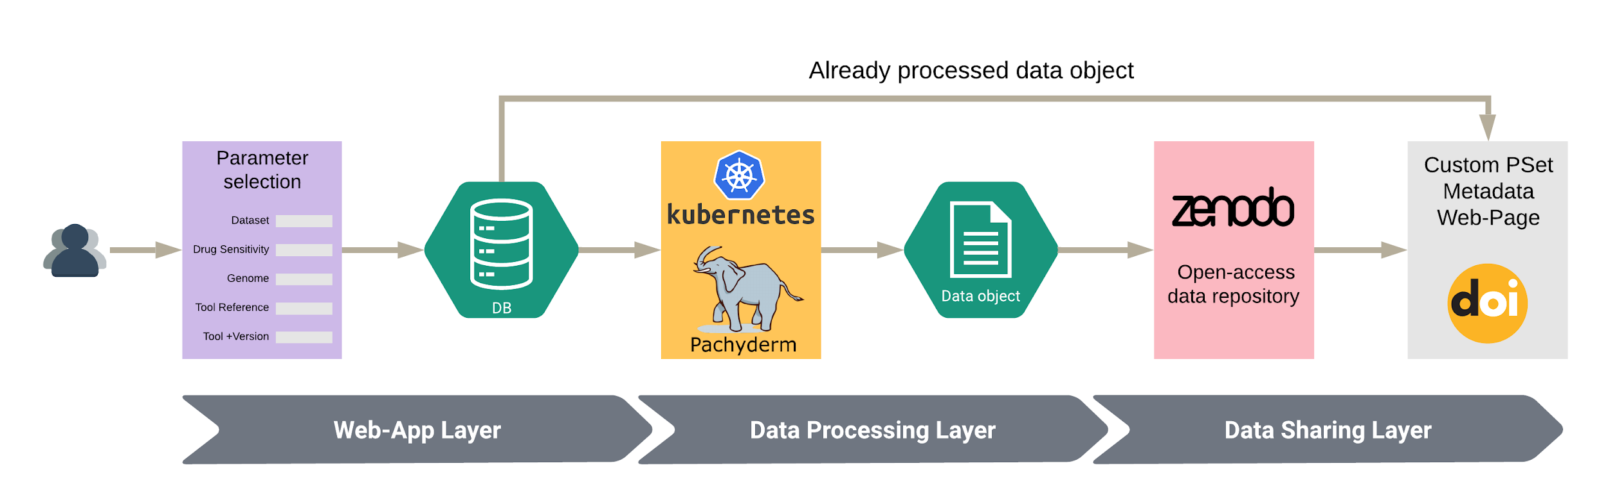

Reproducible processing of multi-omics pharmacogenomic data
Maximize cross-dataset operability by standardizing processing pipelines and annotations

Slide 38
One -omics to rule them all?

Slide 39
Key papers
Papers comparing different omics for drug response prediction:
Costello NBT 2014 (https://www.ncbi.nlm.nih.gov/pmc/articles/PMC4547623/)
Roumeliotis Cell Reports 2017 (https://www.cell.com/cell-reports/comments/S2211-1247(17)31100-2)
Iorio Cell 2016: https://www.cell.com/fulltext/S0092-8674(16)30746-2
Webber Cell Systems 2018: https://doi.org/10.1016/j.cels.2018.10.001

Slide 40
Assessing the value of multi-omics for biomarker discovery
Generating multi-omics profiles remains a costly process
→ Need to maximize the return on investment
What is the best -omics layer to identify biomarkers?
Are -omics layers redundant? Does convergence of signal enable the discovery of more robust biomarkers?
Are -omics layer complementary?Are all the -omics profiles necessary to develop predictors of drug response?

Slide 41
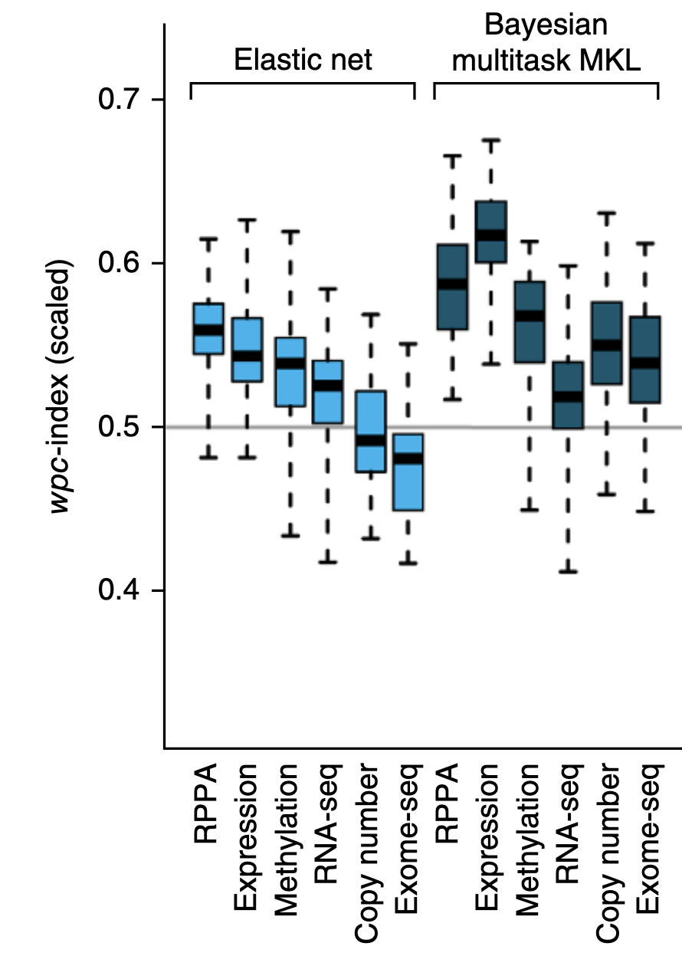
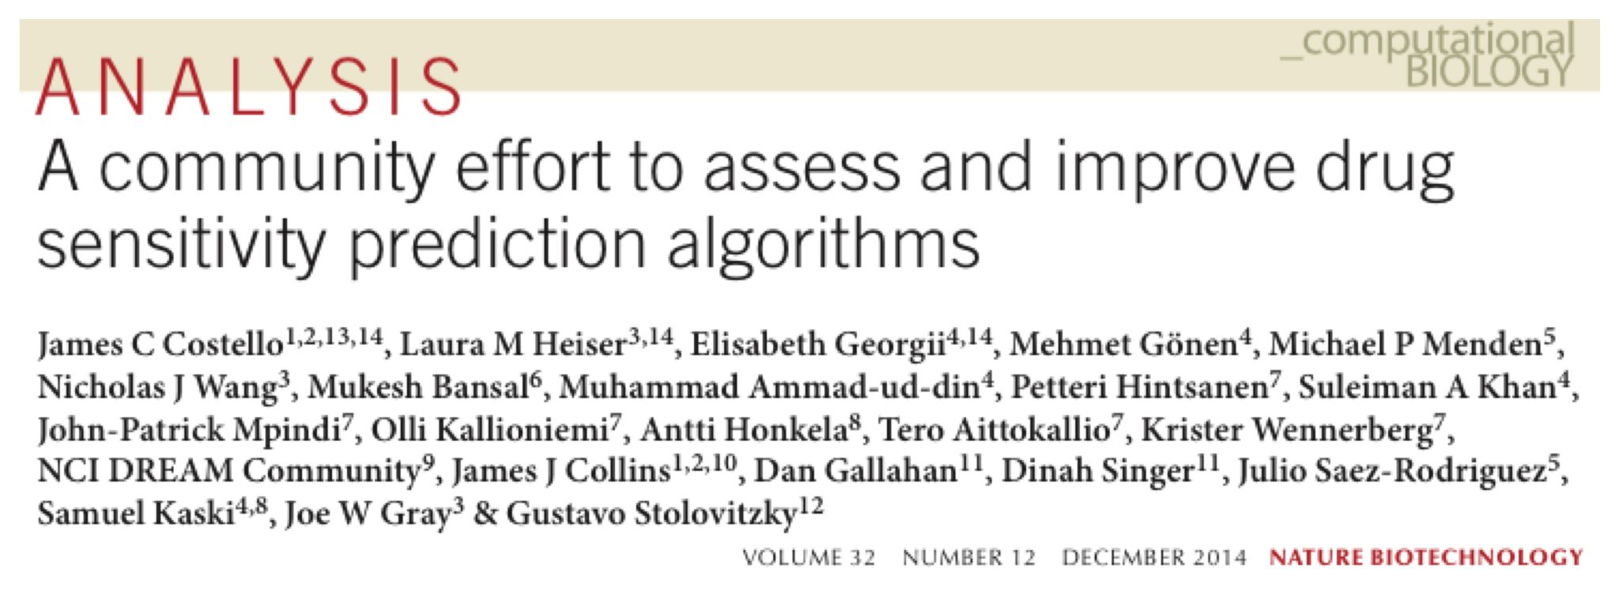
One -omics to rule them all? - Costello et al. 2014
35 breast cancer cell lines to develop multivariate predictors of response to 28 drugs
Validation of predictions in 18 breast cancer cell lines
Open Competition: DREAM Challenge
ElasticNet + winning model: Bayesian Multitask Multiple Kernel Learning (MKL)
Notes:
“We observed that gene expression was the most informative data set in many approaches, which may partly reflect the fact that analysis tools for this data type are more abundant and advanced. That is, we do not yet know the best approaches to extract predictive information from the other large profiling data sets; in particular the sparsity of exome sequencing data requires novel analysis methods36. However, when combined with expression data, these other data sets can enhance prediction performance.”

Slide 42
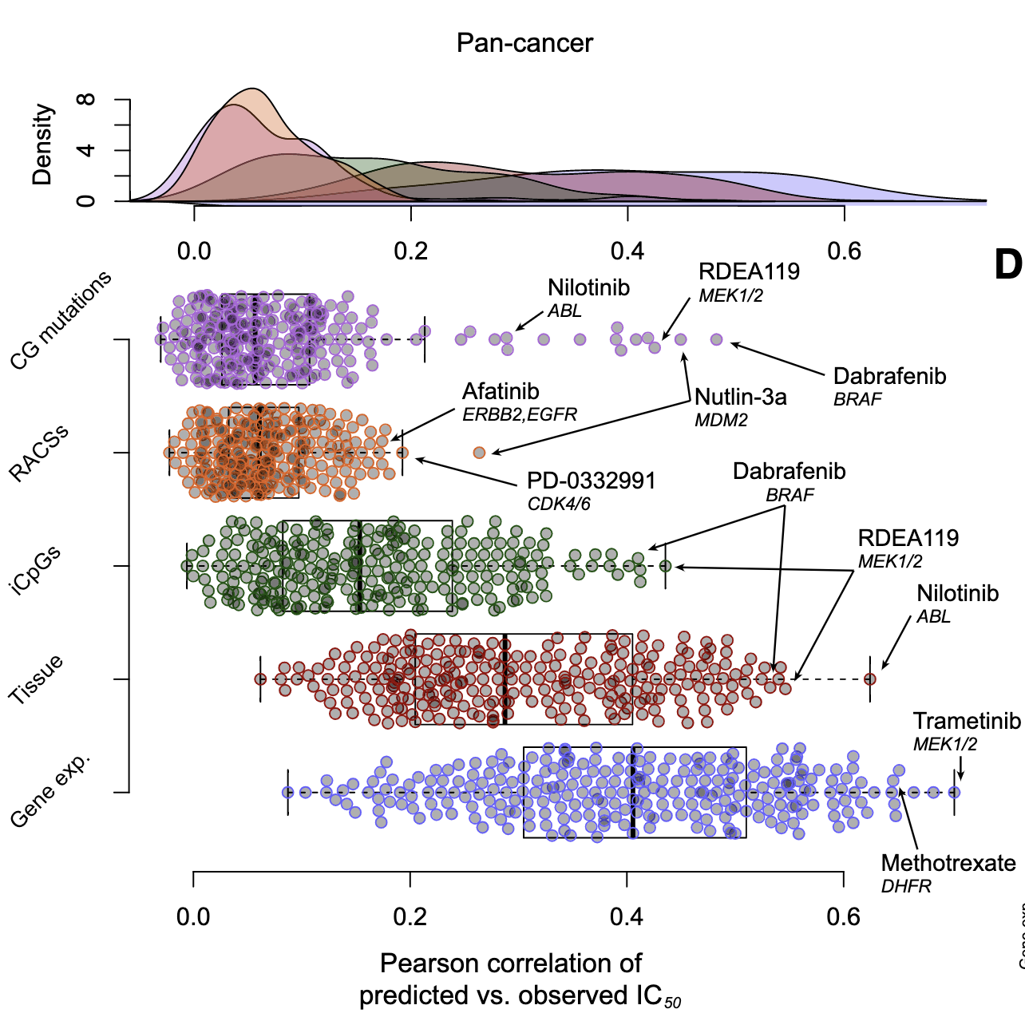
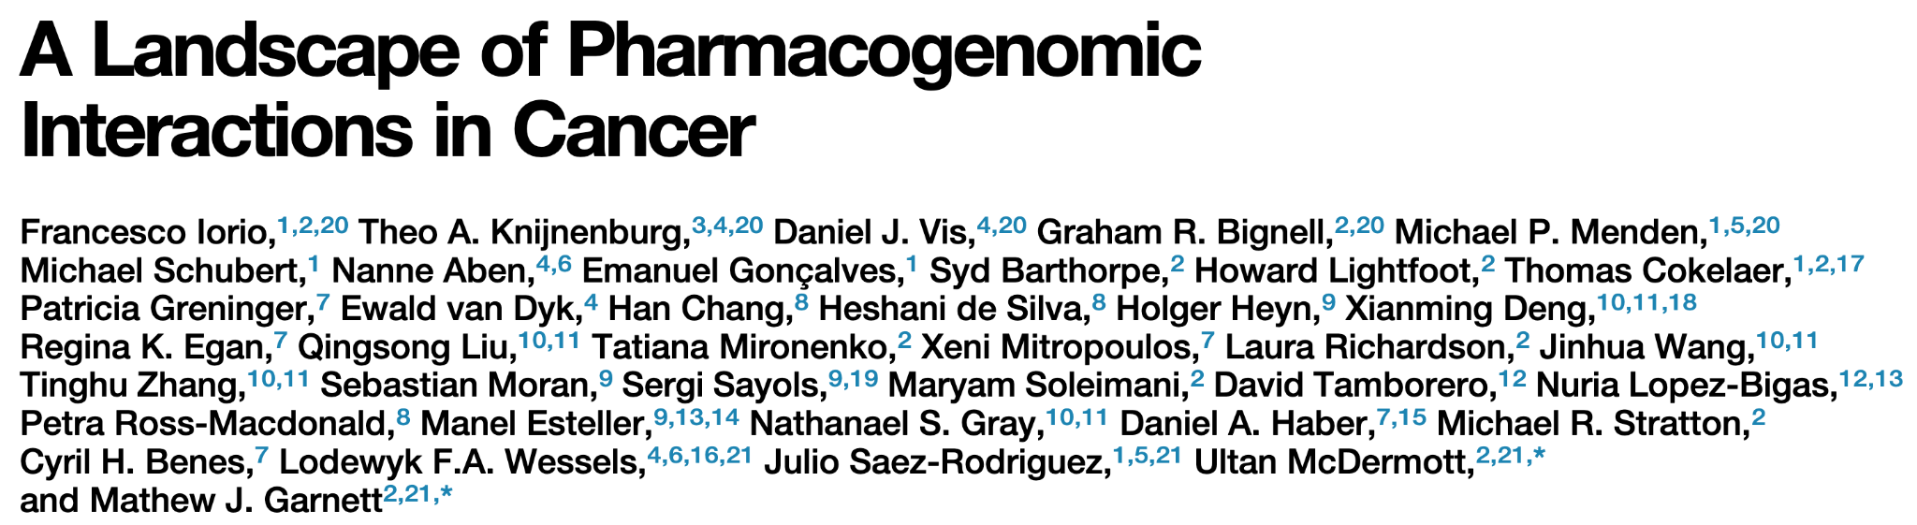

One -omics to rule them all? - Iorio et al. 2016
~1000 cell lines (pancancer)
265 drugs
ElasticNet in 5-fold cross-validation
Gene expression (microarray) is the most predictive -omics layer
Notes:
“1) cancer genes (CGs) for which the mutation pattern in whole-exome sequencing (WES) data is consistent with positive selection, 2) focal recurrently aberrant copy number segments (RACSs) from SNP6 array profiles, and 3) hypermethylated informative 50 C-phosphate-G-30 sites in gene promoters (iCpGs) from DNA methylation data, hereafter collectively referred to as ‘‘Cancer functional events’’ (CFEs).”

Slide 43
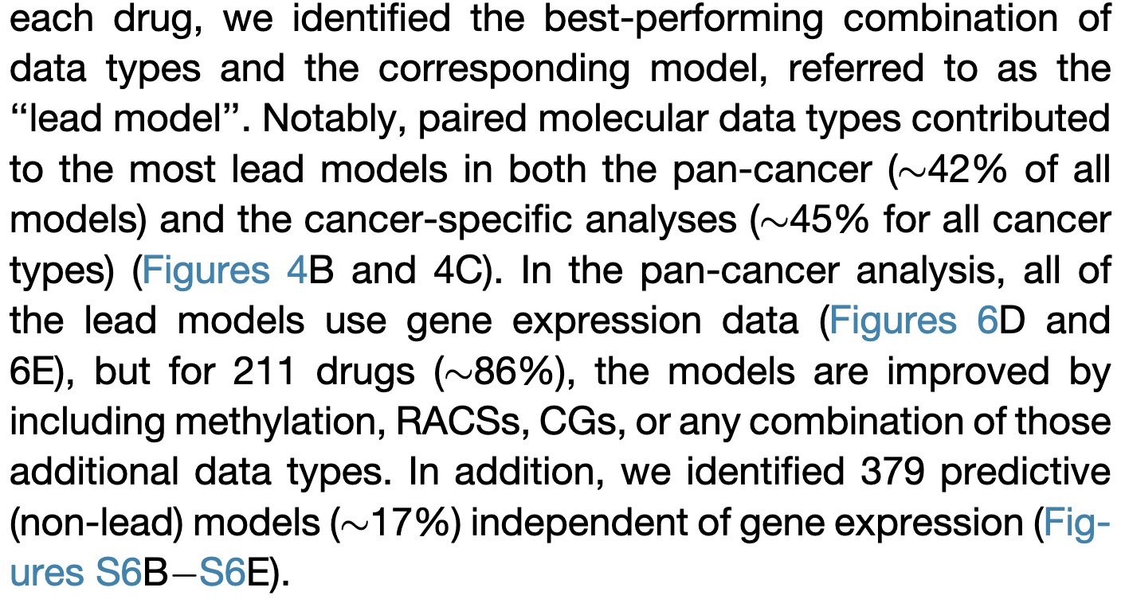
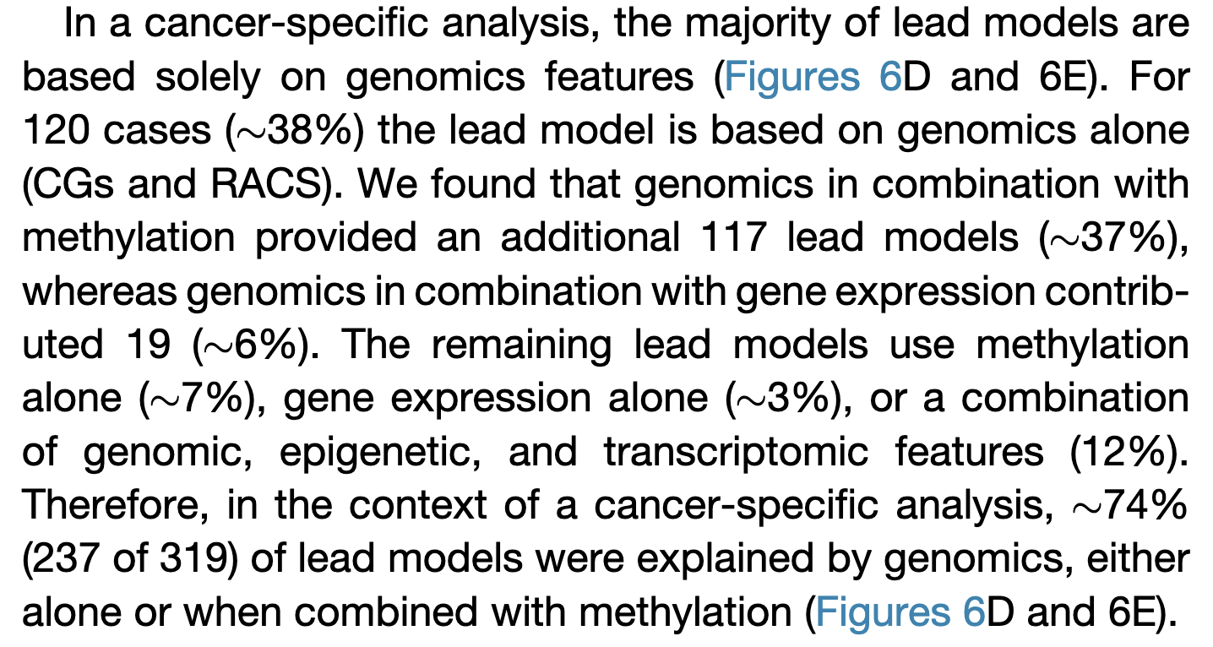
Iorio Cell 2016

Slide 44
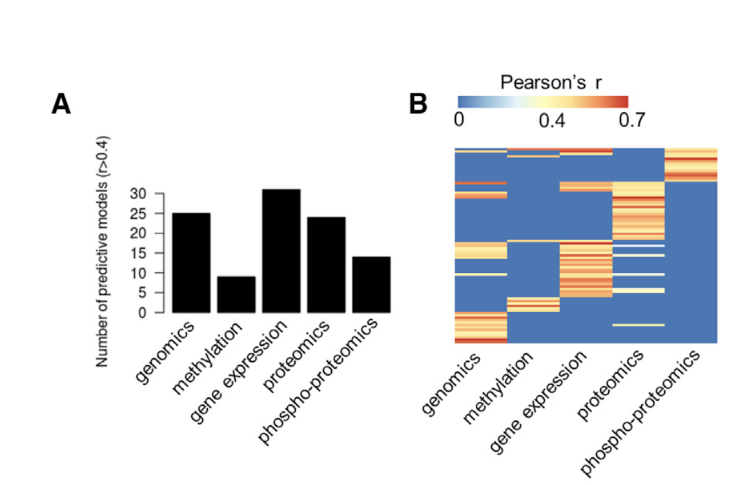
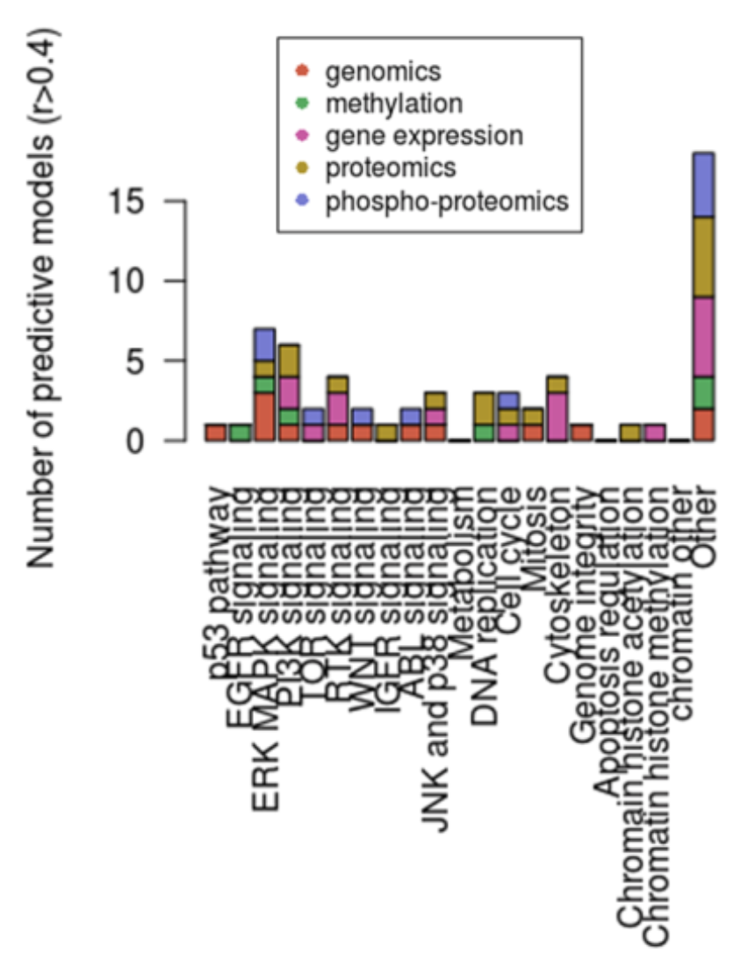

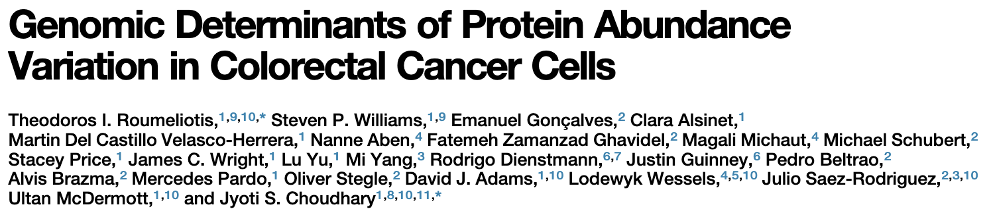
One -omics to rule them all? - Roumeliotis et al. 2017
50 colorectal cancer cell lines
Gene expression is the best data modality to develop predictors of drug response (ElasticNet), methylation is the worst
Number of predictive
models (drugs)
But all the data modalities are important as they are relevant for different pharmacological classes!
Drugs per pharmacological classes
Notes:
“The number of drugs for which predictive models (i.e., models where the Pearson correlation between predicted and observed IC50s exceeds r > 0.4) could befitted is stratified per data type.
Heatmap indicating for each drug and each data type whether a predictive model could be fitted. Most drugs were specifically predicted by one data type.”

Slide 45
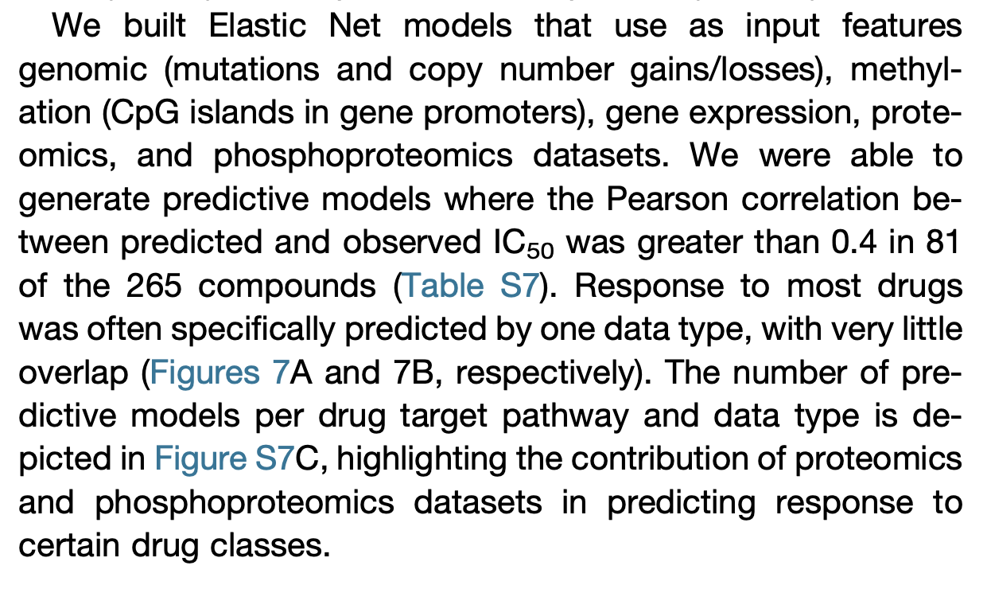
Roumeliotis
Colorectal

Slide 46
Combining -omics

Slide 47
Combining multi-omics data for biomarker discovery
Single layer can be highly predictive, depends on the drugs
Complementarity in majority of cases
Pan-cancer → gene expression + methylation
Cancer-specific → genomics and methylation
Proteomics and phospho-proteomics promising but understudied

Slide 48
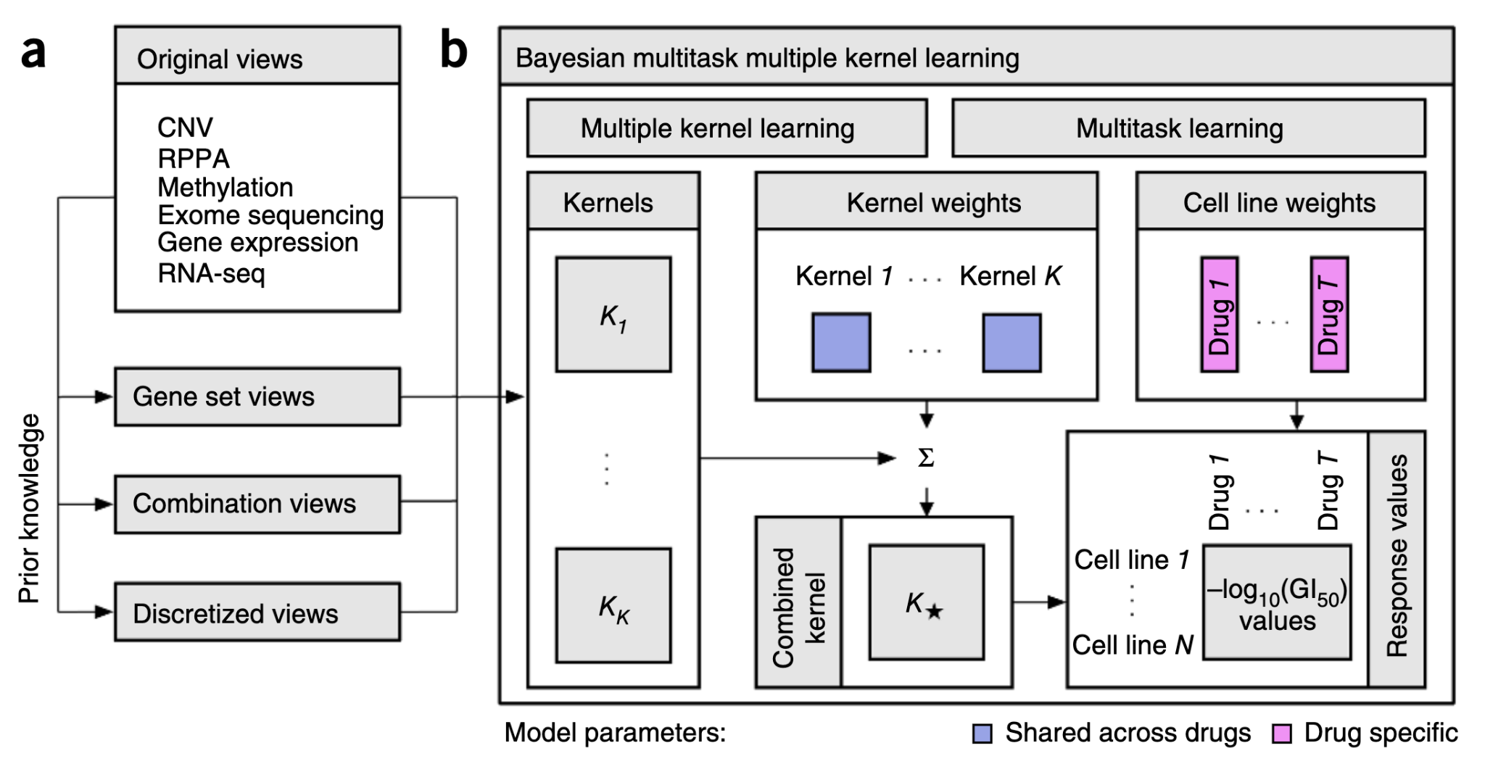
Aittokallio 2014: multi-view multi-task kernel
Notes:
The method implemented by the best performing team. (a) In addition to the six profiling data sets, three different categories of data views were compiled using prior biological knowledge, yielding in total 22 genomic views of each cell line. (b) Bayesian multitask MKL combines nonlinear regression, multiview learning, multitask learning and Bayesian inference. Nonlinear regression: response values were computed not directly from the input features but from kernels, which define similarity measures between cell lines. Each of the K data views was converted into an N×N kernel matrix Kk(k = 1,...,K), where N is the number of training cell lines. Specifically, the Gaussian kernel was used for real-valued data, and the Jaccard similarity coefficient for binary-valued data. Multiview learning: a combined kernel matrix K* was constructed as a weighted sum of the view-specific kernel matrices Kk, k = 1,...,K. The kernel weights were obtained by multiple kernel learning. Multitask learning: training was performed for all drugs simultaneously, sharing the kernel weights across drugs but allowing for drug-specific regression parameters, which for each drug consisted of a weight vector for the training cell lines and an intercept term. Bayesian inference: the model parameters were assumed to be random variables that follow specific probability distributions. Instead of learning point estimates for model parameters, the parameters of these distributions were learned using a variational approximation scheme.

Slide 49

Combining multi-omics - Costello et al. 2014
Combining multiple -omics data layer increases the dimensionality of the feature space
Richer information but comes at a cost
Feature selection is more difficult
Higher risk of overfitting
ElasticNet fails to improve with the additional features but the Bayesian Multitask MKL model achieve higher performance!
multi-omics
ElasticNet
Bayesian
Multitask MKL

Slide 50



Combining multi-omics - Iorio et al. 2016
Combination of layers is cancer -specific
Few models benefit from the integration of all layers
Transcriptomics is highly predictive pan-cancer and genomics specific cancer types
Methylation
CNV
Mutations
Gene exp

Slide 51



Combining multi-omics - Webber et al. 2017
Features correlated across -omics layers → convergence

Slide 52


Combining multi-omics - Webber et al. 2017

Slide 53
Combining multi-omics - Webber et al. 2017
Modules
Modules
Modules
Modules
Modules
Modules
Genes
Genes
Genes
Genes
Genes
Genes

Slide 54




Single-omics with other modalities - Sang Lee et al. 2021
Harnessing genetic interactions to predict patient response to cancer therapy
Notes:
Generating an initial pool of SL drug target interactions for targeted therapy. To identify clinically relevant SL interactions for targeted therapies, we followed the three-step procedure described in (Lee et al., 2018). (1) We created an initial pool of SL pairs identified in cell lines via RNAi/CRISPR-Cas9 (Aguirre et al., 2016; Cheung et al., 2011; Cowley et al., 2014; Marcotte et al., 2012; Marcotte et al., 2016) or pharmacological screens (Barretina et al., 2012; Basu et al., 2013; Iorio et al., 2016). For drug target gene T and candidate SL partner gene P, we checked whether the growth reduction induced by knocking out/down gene T or pharmacologically inhibiting gene T is stronger when gene P is inactive via a Wilcoxon rank-sum test. (2) Second, among the candidate gene pairs from the first step, we selected those gene pairs whose coinactivation is associated with better prognosis in patients, using a Cox proportional hazard model, testifying that they may thus hamper tumor progression. Third, we prioritized the SL paired genes with similar phylogenetic profiles across different species. Because of the distinct distribution of p values for the first two screens as shown in Figure S2, we performed a false discovery correction with 1% for the in vitro screen (1st step) and 10% for the tumor screen (2nd step). We were able to identify significant SL partners with these FDR thresholds for most of the datasets.

Slide 55

Single-omics with other modalities - Sang Lee et al. 2021
Finding synthetic lethal partners using genetic and pharmacological perturbations

Slide 56



Single-omics with other modalities - Sang Lee et al. 2021
Predicting patients’ response to therapy using transcriptomics only

Slide 57


Single-omics with other modalities - Sang Lee et al. 2021
Prediction in published clinical trials

Slide 58
Research transparency and reproducibility

Slide 59






Capsule for multi-omics biomarker discovery
Code
R
Shiny
Results
Environment
R Studio
Ubuntu
Data
CCLE
Explore CCLE Capsule
Gene expression of cancer cell lines
https://codeocean.com/capsule/0762056/tree/v1
https://codeocean.com/capsule/9218077/tree

Slide 60
Take-home messages
Multi-omics and machine learning hold the potential to move precision oncology forward
More predictors of drug response are needed to guide treatment decision
Large, standardized and well-annotated datasets are necessary
ORCESTRA facilitate the processing, versioning and dissemination of multimodal / multi-omics datasets
More data from clinical trials will be required to develop and test predictors to translate them into clinical settings
Multi-omics predictors do not always outperform single-omics predictors
But the choice of -omics layer strongly depends on the drugs’ mechanism of action
“Convergence of signal” helps achieve higher predictive value
Predictive value and correlation across multiple -omics layers
Similarity between tumors and preclinical cancer models

Slide 61
Resources for multi-omics in biomarker discovery
DepMap: depmap.org/portal/interactive/
CancerRxGene: cancerrxgene.org/
DrugCombDB: drugcombdb.denglab.org/
DrugComb: drugcomb.fimm.fi/
SynergyFinder: synergyfinder.fimm.fi/ / bioconductor.org/packages/synergyfinder/
PDXFinder: https://www.pdxfinder.org/
CancerDrugeXplorer: http://cancerdrugexplorer.org/
CellMinerCDB: https://discover.nci.nih.gov/cellminercdb/
GDSCTools: https://gdsctools.readthedocs.io/en/master/
CancerDP: https://crdd.osdd.net/raghava/cancerdp/

Slide 62

Resources for multi-omics in biomarker discovery
Pharmacogenomics
PharmacoGx: bioconductor.org/packages/PharmacoGx/
ORCESTRA: orcestra.ca/pset
PharmacoDB: pharmacodb.ca/
SYNERGxDB: synergxdb.ca/
XevaDB: xevadb.ca/
Xeva: bioconductor.org/packages/Xeva/
Radiogenomics
RadioGx: bioconductor.org/packages/RadioGx/
Toxicogenomics
ToxicoGx: bioconductor.org/packages/ToxicoGx/
ToxicoDB: toxicodb.ca/

Slide 63





Acknowledgements
BHK lab → bhklab.ca
Princess Margaret Cancer Centre
Collaborators
Trevor Pugh
Philippe Bedard
Lillian Siu
David Cescon
Mathieu Lupien
John Stagg (University of Montreal, Canada)
Tero Aittokallio (Institute for Cancer Research, Norway)
Marc Hafner (Genentech, US)
Simon Adar, David Butler, Sharron Gottlieb (Code Ocean, US)
Funding:
The Gattuso Slaight Personalized Cancer Medicine Fund

Slide 64
Thank you for your attention
Software packages and web-applications available from: https://www.bhklab.ca

